Slide 1
Cardio-Vascular Disease
Hypertension
Dr Sandeep Rai

Slide 5
Hypertension
High BP is a trait as opposed to a specific disease.
Represents a quantitative rather than a qualitative deviation from the normal.
Level of BP at which the benefits of treatment outweigh the costs and hazards.
Hypertension is a condition in which arterial BP is chronically elevated.

Slide 6
Hypertension and Its risk
leading causes of the global burden of disease.
Approximately 7.6 million deaths (13
–15% of the total) and 92 million disability- adjusted life years worldwide (2001)
Doubles the risk of cardiovascular diseases
often is associated with additional cardiovascular disease risk factors.
Antihypertensive therapy clearly reduces the risks of cardiovascular and renal disease
But large segments of the hypertensive population are either untreated or inadequately treated.

Slide 9
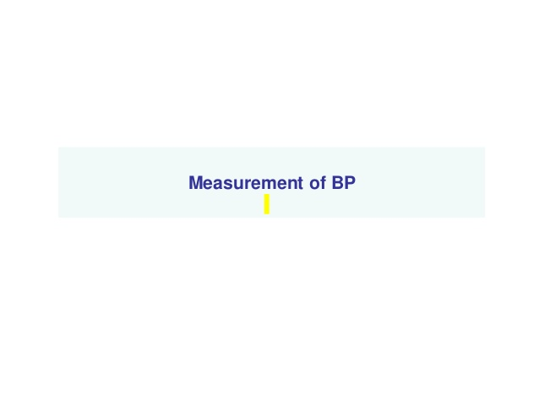

Slide 11
Ambulatory BP recording

Slide 13
Etiology
It may be either
Essential (90-95 %): Unknown specific cause – multifactorial.
Environmental factors
Genetic factors
Fetal factors
Humoral mechanisms
Insulin resistance - Metabolic syndrome
Secondary: consequence of a specific disease or abnormality leading to sodium retention and/or peripheral vasoconstriction

Slide 14
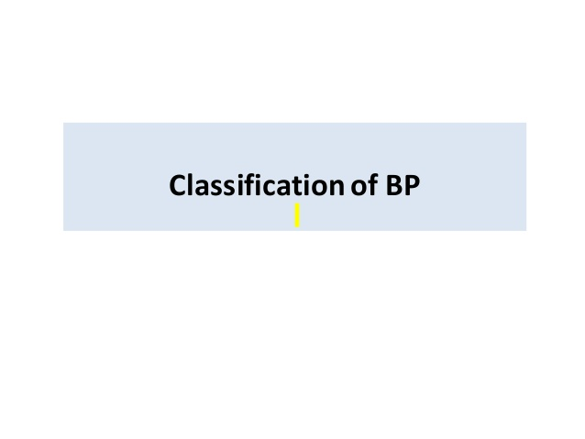

Slide 16
Essential hypertension
Genetic factors
tends to run in families, by shared environmental influences.
still largely unidentified genetic component.
Fetal factors
Low birth weight: May be due to fetal adaptation to intrauterine undernutrition with
long-term changes in blood vessel structure
Or the function of crucial hormonal systems.

Slide 17
Essential hypertension
Environmental factors
Obesity
Fat people have higher blood pressures than thin people.
Sleep disordered breathing often seen with obesity may be an additional risk factor
Alcohol intake
close relationship between the consumption of alcohol and blood pressure level.
But small amounts of alcohol seem to be beneficial
Sodium intake
Directly proportional
some evidence that a high potassium diet can protect against the effects of a high sodium intake
Stress
Chronic stress – uncertain
acute pain or stress can raise blood pressure

Slide 18
Essential hypertension
Humoral mechanisms
autonomic nervous system, reninangiotensin system, natriuretic peptide and kallikrein-kinin system - short- term changes in blood pressure
But no convincing evidence - directly involved in the maintenance of hypertension
Insulin resistance - Metabolic syndrome
hyperinsulinaemia, glucose intolerance, reduced levels of
HDL cholesterol, hypertriglyceridaemia and central obesity with
with hypertension
association between diabetes and hypertension has long been recognized

Slide 19
Secondary Hypertension
Pregnancy (pre-eclampsia)
Renal disease
Renal vascular disease
Parenchymal renal disease, particularly glomerulonephritis
Polycystic kidney disease
Drugs
Oral contraceptives containing oestrogens
Anabolic steroids,
Corticosteroids
NSAIDs, carbenoxolone,
Sympathomimetic agents
Coarctation of the aorta

Slide 20
Secondary Hypertension
Endocrine disease
Phaeochromocytoma - vascular tumor of the adrenal gland
Cushing’s syndrome – excessive cortisol
Primary hyperaldosteronism (Conn’s syndrome)
Glucocorticoid-suppressible hyperaldosteronism
Hyperparathyroidism
Acromegaly
Primary hypothyroidism
Thyrotoxicosis
Congenital adrenal hyperplasia due to 11-β-hydroxylase or 17α-hydroxylase deficiency
Liddle’s syndrome
1-β-hydroxysteroid dehydrogenase deficiency

Slide 21
Mechanisms of Hypertension
Determinants of arterial pressure:
Cardiac output
Stroke volume: related to myocardial contractility and to the size of the vascular compartment.
Heart Rate: neuronal and hormonal control
Peripheral resistance: functional and anatomic
changes in small arteries and arterioles

Slide 22
Mechanisms of Hypertension
Intravascular Volume
Sodium is predominantly an extracellular ion -primary determinant of the extracellular fluid volume
When NaCl intake exceeds the capacity of the kidney to excrete sodium
Vascular volume initially expands and cardiac output increases
Autonomic Nervous System
homeostasis via pressure, volume, and chemoreceptor
signals
Adrenergic reflexes - short term,
Adrenergic function, in concert with hormonal and volume-related factors - long-term regulation
three endogenous catecholamines are norepinephrine, epinephrine, and dopamine

Slide 23
Mechanisms of Hypertension
Renin-Angiotensin- Aldosterone
Vasoconstrictor properties of angiotensin II
Sodium-retaining properties of aldosterone

Slide 24
Mechanisms of Hypertension: Vascular Mechanisms
Vascular radius
Resistance to flow varies inversely with the fourth power of the radius,
Compliance of resistance arteries
High degree of elasticity: accommodate an increase of volume with relatively little change in pressure,
Semi-rigid vascular system: small increment in volume induces a relatively large increment of pressure

Slide 25
Complications of Hypertension

Slide 26
Complications: Blood Vessels
Larger arteries (> 1mm)
Internal elastic lamina is thickened, smooth muscle is
hypertrophied and fibrous tissue is deposited
The vessels dilate and become tortuous, and their walls become
less compliant.
Smaller arteries (< 1mm)
hyaline arteriosclerosis
lumen narrows and aneurysms
Atheroma develops : coronary and cerebrovascular disease
Risk factor: smoking, hyperlipidaemia, diabetes
This changes in the vasculature often perpetuate and
aggravate hypertension
Increasing peripheral vascular resistance
Reducing renal blood flow

Slide 27
Complications: Blood Vessels

Slide 28
Complications: Central nervous system
Stroke most common complication
Cerebral haemorrhage or infarction
Subarachnoid haemorrhage
Hypertensive encephalopathy – rare conditions
High BP
Neurological symptoms: transient disturbances of speech or vision, paraesthesiae, disorientation, fits and loss of consciousness.
Neurological deficit - usually reversible if the hypertension is properly controlled

Slide 29
Complications: Central nervous system

Slide 30
Complications: Retina
Optic fundi - gradation of changes linked to the severity of hypertension
Cotton wool exudates
Associated with retinal ischaemia or infarction
Fade in a few weeks
Hard exudates
Assoicated with diabetic retinopathy
small, white, dense deposits of lipid
microaneurysms (‘dot’ haemorrhages)

Slide 31
Complications: Retina
Grade 1
Arteriolar thickening
Tortuosity
Increased reflectiveness - silver wiring
Grade 2
Grade 1
Constriction of veins at arterial crossings - arteriovenous nipping
Grade 3
Grade 2
Retinal ischaemia - flame-shaped or blot haemorrhages and ‘cotton wool’ exudates
Grade 4
Grade 3
papilloedema

Slide 32
Complications: Heart
Coronary artery disease
Very high incidence
Ressure load on the heart
may lead to left ventricular hypertrophy
forceful apex beat and fourth heart sound
Atrial fibrillation
diastolic dysfunction caused by left ventricular
hypertrophy
Or the effects of coronary artery disease.
Left ventricular failure - severe hypertension
Absence of coronary artery disease
Risk factor: impaired renal function, and therefore sodium retention

Slide 33
Complications: Kidneys
Major risk factor for renal injury and end-stage renal disease
Atherosclerotic, hypertension-related vascular lesions - preglomerular arterioles
Resulting in ischemic changes in the glomeruli and postglomerular structures
This leads to reduced GFR and, finally, a reduction in
Na and water excretion
activation of the renin-angiotensin system
May cause proteinuria (>3 g/24 h) or if untreated it may cause Progressive renal failure

Slide 35
Investigation: All patients
Urinalysis for blood, protein and glucose
Blood urea, electrolytes and creatinine
Blood glucose
Serum total and HDL cholesterol
12-lead ECG - left ventricular hypertrophy, coronary artery disease

Slide 36
Investigation: Selected patients
Chest X-ray: cardiomegaly, heart failure, coarctation of the aorta
Ambulatory BP recording: assess borderline or ‘white coat’ hypertension
Echocardiogram: detect or quantify left ventricular hypertrophy
Renal ultrasound: to detect possible renal disease

Slide 37
Investigation: Selected patients
Renal angiography: detect or confirm presence of renal artery stenosis
Urinary catecholamines: possible phaeochromocytoma
Urinary cortisol and dexamethasone suppression test: possible Cushing’s syndrome
Plasma renin activity and aldosterone: possible primary aldosteronism

Slide 40
Management
Initially there should be complete assessment with repeated BP measurements for 6 months until its not severe.
Advice and non-pharmacological measures (Life-style changes) should be given prior to the initiation of drug therapy.
A target of ~140 mm Hg systolic and ≈85 mm Hg diastolic blood pressure is recommended.
– Diabetes, renal impairment or established CVS disease ≈130/80 mmHg is recommended

Slide 45
Pharmocological Management
Decision to commence specific drug therapy - only after a careful period of assessment with lifestyle changes, of up to 6 months.
– Unless its not having end organ damage or other hyperetensive complications
Aim, plan and side effect of drug treatment - carefully explained to the patient.
Patient compliance is very essential for efficacy of drugs – long term results.

Slide 51
Pharmacological Management
The drugs commonly used to treat HT are
Alpha-blockers
Aldosterone antagonists
Angiotensin-converting enzyme inhibitors
Angiotensin II receptor blockers
Beta-blockers
Calcium channel blockers
Centrally acting
Diuretics
Renin inhibitors
Vasodilators

Slide 52
Pharmocological Management

Slide 53
Pharmacological Management

Slide 54
Pharmacological Management

Slide 63
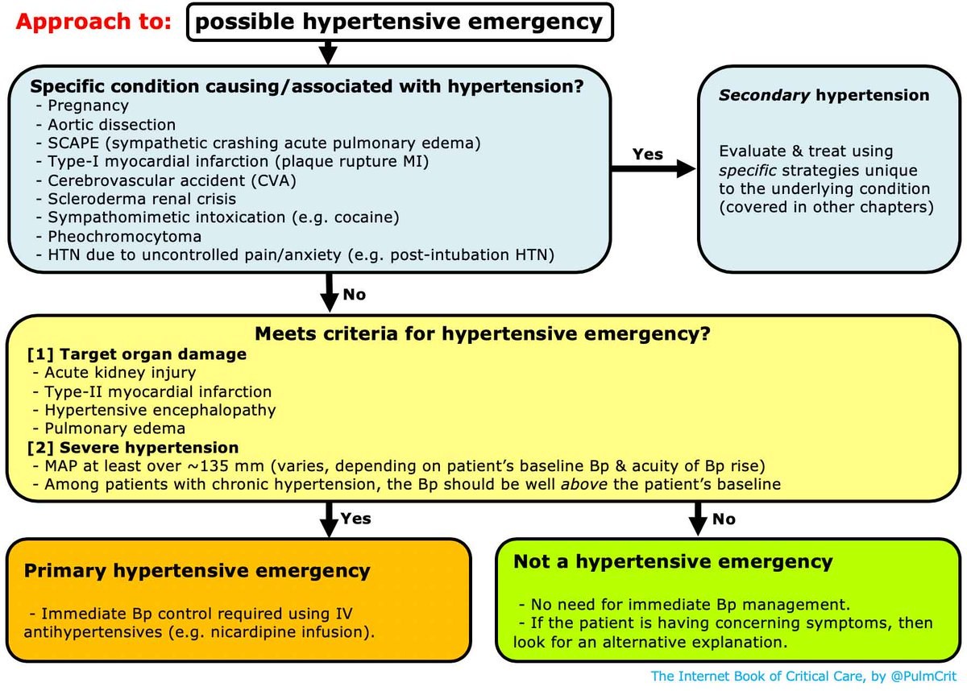

Slide 66
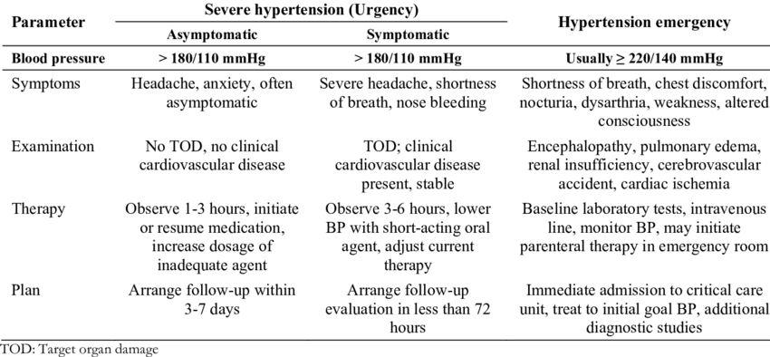

Slide 68
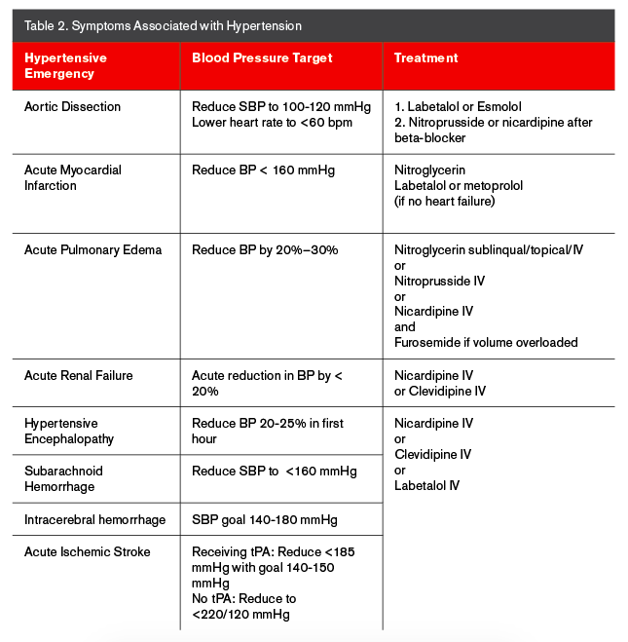

Slide 69
Malignant hypertension
Patient should be hospitalized immediately in case of
severe hypertension (diastolic pressure >140 mmHg),
malignant hypertension (grades 3 or 4 retinopathy),
hypertensive encephalopathy
Or with severe hypertensive complications, such as cardiac failure,
BP should not be reduced too rapidly - cerebral, renal, retinal or myocardial infarction
Reduce the diastolic blood pressure to 100–110 mmHg over 24– 48 hours.
Achieved with oral medication, e.g. amlodipine.
Then BP can be normalized over the next 2–3 days.
When rapid control of blood pressure is required (e.g. in an aortic dissection), the agent of choice is IV sodium nitroprusside or labetalol
The infusion dosage must be titrated against the blood pressure response.

Slide 71
Hypertension in Pregnancy
There are three types of hypertension seen in pregnant women:
Chronic or pre-existing hypertension
Gestational hypertension
Pre-eclampsia and eclampsia
1st line therapy: Methyldopa (no adverse effects on the fetus)
2nd line agents: Nifedipine and labetalol.
The target blood pressure should be <150/100 mmHg
Gestational hypertension: >140/90 mmHg in the 2nd trimester in a previously normotensive woman.
risk of developing pre-eclampsia

Slide 72
Pre-eclampsia
Multi-system disorder that occurs after 20 weeks’ gestation consisting of:
Hypertension
Oedema
Proteinuria (>0.3 g/24 hours).
These patients should be admitted and treated for hypertension with regular
BP measurements (4 times daily)
blood tests 2–3/week.
close fetal monitoring due to the risks of placental insufficiency and intrauterine growth retardation.
Patients who progress to eclampsia (convulsions) and/or HELLP (haemolysis, elevated liver enzymes, low platelet count) syndrome should be admitted to a critical care unit (CCU)
intravenous hydralazine, labetalol, and magnesium sulphate (for
convulsions)
Prompt delivery.

Slide 73
Prognosis
Depends on a number of features:
Level of blood pressure
Presence of target-organ changes (retinal, renal, cardiac or vascular)
Co-existing risk factors for cardiovascular disease, such as hyperlipidaemia, diabetes, smoking, obesity, male sex
Age at presentation.
Several studies have confirmed that the treatment of hypertension, even mild hypertension, will reduce the risk not only of stroke but of coronary artery disease as well.

