Slide 1
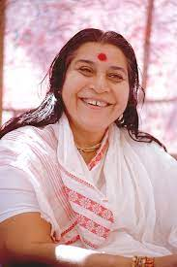
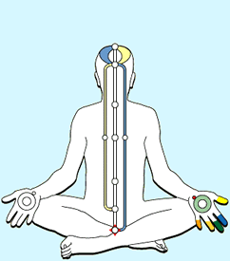
Sudden cardiac Arrest & Sudden death (SCD)
Sudden cardiac death (SCD)
DR. SANDEEP RAI
PROFESSOR & UNIT HEAD
POST GRADUATE DEPARTMENT OF MEDICINE
MGM INSTITUTE OF HEALTH SCIENCES
NAVI MUMBAI

Slide 2
INTRODUCTION
Sudden cardiac
cardiac arrest (SCA)
and sudden
the sudden
with
hemodynamic collapse
If an intervention (eg defibrillation) restores circulation, the event is referred to as SCA
If uncorrected, an SCA event leads to death and is then referred to as SCD
death (SCD) refer to
cessation of cardiac
activity

Slide 3
SCD : Definition
Sudden cardiac death (SCD) is unexpected, abrupt natural death from cardiac causes within 1 hour of symptom onset

Slide 4
Classification
Ventricular arrhythmias:
Monomorphic VT
Polymorphic VT
VF
Bradyarrhythmias:
Asystole
Pulseless electrical activity (PEA)

Slide 5
Epidemiology
SCD accounts for 15% of all deaths and 50% of cardiac-related deaths
Overall incidence is 1-2 per 1000 each year (0.1-0.2%)
Mean survival rate of out-of-hospital cardiac arrest is
<10% to 20%
In high-risk groups (eg CAD), the incidence is 100-120 per 1000 per year (10-12%)
However, more than two-thirds of patients who die from SCD are considered “low risk” with either no known cardiac risk factors or “low-risk” CAD

Slide 7
Etiology
Channelop athies, Valvular, or Inflammat ory causes
Non- ischemic Cardiomy opathies
Coronary Artery Disease : 80%
Non-ischemic Cardiomyopathies : 10 - 15%
Channelopathies, Valvular or
Inflammatory causes : 5 - 10%
Coronary Artery Disease

Slide 15
Acute Management
Rapid recovery efforts are critical
The time between onset and resuscitation has a dramatic effect on the rate of success
Irreversible brain damage begins within 5 minutes of arrest

Slide 16
THE INITIAL ASSESSMENT

Slide 17
The Initial Assessment
Make
sure the scene is safe before
approaching the individual
The first
assessment is whether they are
conscious or unconscious
If unconscious, start with BLS Survey and move on to ACLS Survey
If conscious, start with ACLS Survey

Slide 18
BASIC LIFE SUPPORT

Slide 19
INITIATING THE CHAIN OF SURVIVAL
Early initiation of BLS has been shown to increase the probability of survival for an individual dealing with cardiac arrest

Slide 25
Recent BLS Guidelines
The change from the traditional ABC (Airway, Breathing, Compressions) sequence to the CAB (Compressions, Airway, Breathing)
The emphasis on early initiation of compressions without delay for
chest airway
assessment or rescue breathing has resulted in improved outcomes

Slide 28
BLS guidelines cont…
Chest compressions at a rate of 100 to 120 per minute
Chest compressions at a depth of 2 to 2.4 inches (5 to 6 cm), greater depths may result in injury to vital organs
Full chest recoil in between compressions to promote cardiac filling
Interruptions of chest compressions, including pre and post-AED shocks should be as short as possible

Slide 29
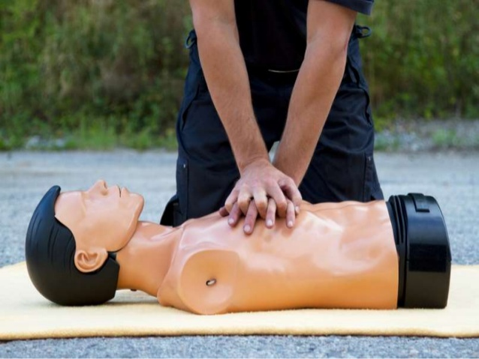

Slide 30
BLS guidelines cont…
Compression to ventilation
ratio 30:2 for an
should
individual without an advanced airway
Individuals with an advanced airway
receive uninterrupted chest compressions with ventilations at a rate of one every six seconds
In cardiac arrest, the defibrillator should be used as soon as possible
Standard dose epinephrine (1 mg every 3 to 5 min) is the preferred vasopressor

Slide 31
Simple Adult BLS Algorithm

Slide 32
CPR Steps
Check for carotid pulse. Never waste time trying to feel carotid for more than 10 seconds. If not sure, begin CPR
Use the heel of one hand on the lower half of the sternum in the middle
of the chest. Put your other hand on top of the first hand
Straighten your arms and press straight down
Compressions should be at least two inches into the person’s chest and at a rate of 100 to 120 compressions per minute. Allow the chest wall to return to its natural position

Slide 33
CPR Steps cont…
After 30 compressions, stop compressions and open the airway by tilting the head and lifting the chin.
Do not perform the head-tilt-chin lift maneuver if you suspect the
person may have a neck injury. In that case the jaw-thrust is used
Give a breath while watching the chest rise. Repeat while giving a second breath. Breaths should be delivered over one second
Resume chest compressions. Switch quickly between compressions and rescue breaths to minimize interruptions in chest compressions

Slide 34
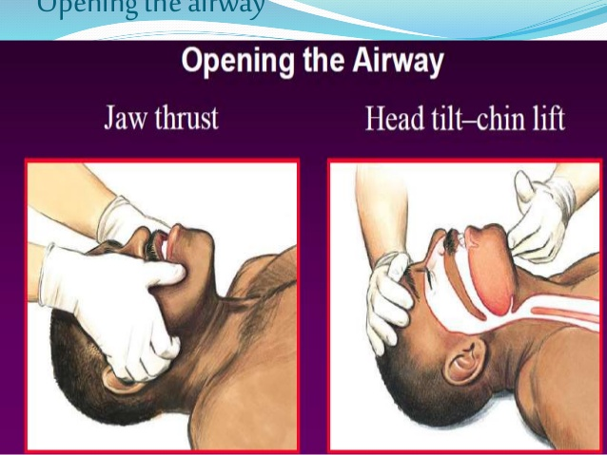

Slide 35
ONE-RESCUER BLS/CPR FOR ADULTS
Be Safe
Move the person out of traffic/ water and dry the person.
Be sure you do not become injured yourself.
Assess the Person
Shake the person and talk to them loudly.
Check to see if the person is breathing.
Call EMS
Send someone for help and to get an AED.
If alone, call for help while assessing for breathing and pulse.
CPR
Check pulse.
Begin chest compressions and delivering breaths.
Defibrillate
Attach the AED when available.
Listen and perform the steps as directed.

Slide 36
TWO-RESCUER BLS/CPR FOR ADULTS
The second rescuer prepares the AED for use.
Begin chest compressions and count the compressions out loud.
The second rescuer applies the AED pads.
The second rescuer opens the person’s airway and gives rescue
breaths.
Switch roles after every five cycles of compressions and breaths. One cycle consists of 30 compressions and two breaths.
Quickly switch between roles to minimize interruptions in
delivering chest compressions.
When the AED is connected, minimize interruptions of CPR by switching rescuers while the AED analyzes the heart rhythm.
If a shock is indicated, minimize interruptions in CPR.
Resume CPR as soon as possible.

Slide 39
ADULT MOUTH-TO-MASK VENTILATION

Slide 40
ADULT BAG-MASK VENTILATION IN TWO-RESCUER CPR

Slide 42
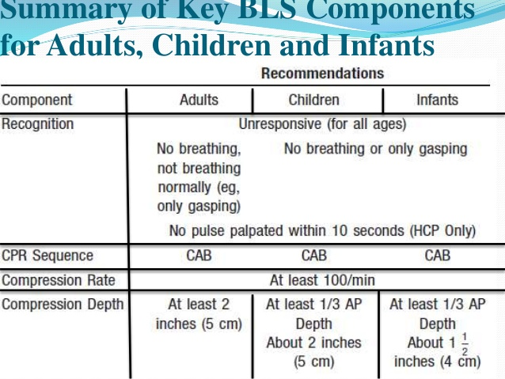

Slide 43
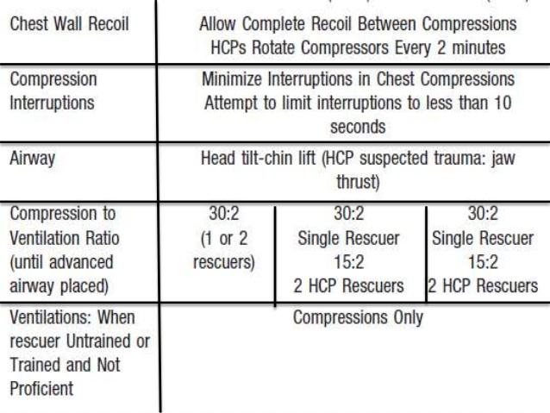

Slide 46
SELF-ASSESSMENT FOR BLS

Slide 47
1. Which of the following is true regarding BLS?
It is obsolete
Recent changes prohibit mouth-to-mouth
It should be mastered prior to ACLS
It has little impact on survival

Slide 48
1. C
ACLS providers are presumed to have mastered BLS skills. CPR is a critical part of resuscitating cardiac arrest victims.

Slide 49
2. What is the first step in the assessment of an individual found “down”?
Check their blood pressure
Check their heart rate
Check to see if they unconscious
Check their pupil size
are conscious or

Slide 50
2. C
When responding to an individual who is “down,” first determine if they are conscious or not. That determination dictates whether you start the BLS Survey or the ACLS Survey.

Slide 51
in any emergency
3. What factor is critical situation?
Scene safety
Age of the individual
Resuscitation status
Pregnancy status

Slide 52
3. A
Always assess the safety of the scene in any emergency situation. Do not become injured yourself.

Slide 53
4. How did the BLS guidelines change with the recent AHA update?
Ventilations compressions
ABC is now CAB
are performed before
Use of an AED is no longer recommended
Rapid transport is recommended over on- scene CPR

Slide 54
4. B
The focus is on early intervention and starting CPR. Look, listen, and feel has been removed to encourage performance of chest compressions.

Slide 55
5. Arrange the BLS Chain of Survival in the proper order:
Look, listen, and feel
Check responsiveness, call EMS and get AED, defibrillation, and circulation
Check responsiveness, call EMS and get AED, chest compressions, and early defibrillation
Call for help, shock, check pulse, shock, and transport

Slide 56
5. C
The focus is on early CPR and defibrillation.

Slide 57
6. After activating EMS and sending someone for an AED, which of the following is correct for one-rescuer BLS of an unresponsive individual with no pulse?
Start rescue breathing
Apply AED pads
Run to get help
Begin chest compressions

Slide 58
6. D
An unresponsive adult without a pulse must receive CPR, and chest compressions should be initiated immediately followed by ventilation.

Slide 59
ADVANCED CARDIAC LIFE SUPPORT

Slide 63
THE ACLS SURVEY (A-B-C-D)
AIRWAY
Maintain airway in unconscious patient
Consider advanced airway
Monitor advanced airway if placed with quantitative waveform capnography
BREATHING
Give 100% oxygen
Assess effective ventilation with quantitative waveform capnography
Do NOT over-ventilate

Slide 64
THE ACLS SURVEY (A-B-C-D)
CIRCULATION
Evaluate rhythm and pulse
Defibrillation/cardioversion
Obtain IV/IO access
Give rhythm-specific medications
Give IV/IO fluids if needed
DIFFERENTIAL DIAGNOSIS
Identify and treat reversible causes
Cardiac rhythm and patient history
Assess when to shock versus medicate

Slide 65
AIRWAY MANAGEMENT
If bag-mask ventilation is adequate, providers may defer insertion of an advanced airway
The value of securing the airway must be balanced against the need to minimize the interruption in perfusion that results in halting CPR during airway placement

Slide 66
BASIC AIRWAY ADJUNCTS
The oropharyngeal airway (OPA) and the nasopharyngeal airway (NPA)
OPA is placed in the mouth while a NPA is inserted through the nose
Both airway equipment terminate in the pharynx
The main advantage of a NPA over an OPA is that it can be used in either conscious or unconscious individuals because the device does not stimulate the gag reflex

Slide 67
ADVANCED AIRWAY ADJUNCTS
ENDOTRACHEAL TUBE
It is the most technically difficult airway to place; however, it is the
most secure airway available
Only experienced providers should perform ET intubation
This technique requires the use of a laryngoscope
LARYNGEAL MASK AIRWAY
Rapid placement of the LMA device by an ACLS provider
LARYNGEAL TUBE
It is more compact and less complicated to insert
This tube can be inserted blindly

Slide 68
ROUTES OF ACCESS
INTRAVENOUS ROUTE
A peripheral IV line is preferred
Central line access not necessary, as it may cause interruptions in CPR & complications during insertion
INTRAOSSEOUS ROUTE
IO route only if IV access is not available
ENDOTRACHEAL ROUTE
Historically, drugs were administered via ET route
ET absorption of drugs is poor, and optimal drug dosing is unknown

Slide 69
COMMON DRUGS
Adenosine Amiodarone
Narrow PSVT/SVT
VF/pulseless VT
VT with pulse
Symptomatic bradycardia
Specific toxins/overdose(eg Organophosphates)
Shock/CHF
Cardiac Arrest
Anaphylaxis
Symptomatic bradycardia/Shock
Atropine
Dopamine Epinephrine

Slide 70
COMMON DRUGS
Lidocaine
Magnesium Sulfate Procainamide Sotalol
Cardiac Arrest (VF/VT)
Wide complex tachycardia with pulse
Cardiac arrest
Torsades de pointes
Wide QRS tachycardia
VT with pulse (stable)
Tachyarrhythmia
Monomorphic VT

Slide 71
PRINCIPLES OF EARLY DEFIBRILLATION
When a fatal arrhythmia is present, CPR can provide a small amount of blood flow to the heart and the brain, but it cannot directly restore an organized rhythm
Defibrillation disrupts a chaotic rhythm and allow the heart’s normal pacemakers to resume effective electrical activity

Slide 72
AUTOMATED EXTERNAL DEFIBRILLATOR
Attach the pads to the upper right side and lower left side of the individual’s chest
Once the
pads are the the
attached correctly, device will read heart rhythm

Slide 74
AED cont…
Once the rhythm is analyzed, the device will direct you to shock the individual if a shock is indicated
A shock
depolarizes all
at to
heart once,
muscle
cells
attempting
organize its electrical activity

Slide 75
CRITERIA TO APPLY AED
The individual
does not respond to shouting or
shaking their shoulders
The individual is not breathing or breathing ineffectively
The carotid artery pulse cannot be detected

Slide 76
BASIC AED OPERATION
Attach the pads to bare chest (not over medication patches). Dry the chest if necessary
Place one pad on upper right side and the other on the chest a few inches below the left arm
Clear the area to allow AED to read rhythm
If no rhythm in 15 seconds, restart CPR
If AED indicates a shock is needed, clear the individual, making sure no one is touching them and that the oxygen has been removed
Press the “Shock” button
Immediately resume CPR starting with chest compressions
After two minutes of CPR, analyze the rhythm with the AED
Continue to follow the AED prompts

Slide 83
SHOCKABLE RHYTHMS
VENTRICULAR FIBRILLATION
VENTRICULAR TACHYCARDIA

Slide 84
UNSHOCKABLE RHYTHMS
Pulseless electrical activity (PEA)
Asystole

Slide 105
SUMMARY ADULT CARDIAC ARREST ALGORITHM
CPR Quality
Push hard (≥ 2 inches) and fast (≥ 100 bpm) and allow chest recoil
Minimize interruptions
Do not over ventilate
If no advanced airway, 30:2 compression to ventilation ratio
Quantitative waveform capnography
Shock Energy
Biphasic: Biphasic more effective than older monophasic waveforms. Follow manufacturer recommendation (e.g., initial dose of 120 to 200 J); if unknown, use maximum available. Second and subsequent doses should be equivalent, and higher doses should be considered.
Monophasic: 360 J

Slide 106
ACLS ALGORITHM Cont…
Return of Spontaneous Circulation
Return of pulse and blood pressure
Sudden sustained increase in PETCO2 (typically ≥ 40 mm Hg)
Spontaneous arterial pressure waves with intra-arterial monitoring
Advanced Airway
Supraglottic advanced airway or ET intubation
Waveform capnography to confirm and monitor ET tube placement
8 to 10 breaths per minute with continuous chest compressions

Slide 107
ACLS ALGORITHM Cont…
Drug Therapy
Epinephrine IV/IO Dose: 1 mg every 3 to 5 minutes
Amiodarone IV/IO Dose: first dose is 300 mg bolus, second dose is 150 mg
Reversible Causes
Hypovolemia
Hypoxia
H+(acidosis)
Hypothermia
Hypo-/hyperkalemia
Tamponade, cardiac
Toxins
Tension pneumothorax
Thrombosis, pulmonary or coronary

Slide 109
SELF-ASSESSMENT FOR ACLS

Slide 110
1. What is the longest a rescuer should pause to check for a pulse?
20 seconds
10 seconds
5 seconds
Less than 2 seconds

Slide 111
1. B
Pulse checks are limited to no more than 10 seconds. If you are unsure whether a pulse is present, begin CPR.

Slide 112
2. The following are included in the ACLS Survey:
Airway, Breathing, Circulation, Differential Diagnosis
Airway, Breathing, Circulation, Defibrillation
Assessment, Breathing, Circulation,
Defibrillation
Airway, Breathing, CPR, Differential Diagnosis

Slide 113
2. A

Slide 114
3. What is the role of the second rescuer during a cardiac arrest scenario?
Summon help.
Retrieve AED.
Perform ventilations.
All of the above

Slide 115
3. D
Take advantage of any bystander and enlist their help based on their skill level.

Slide 116
4. Which of the following is not an example of an advanced airways?
Oropharyngeal airway
Esophageal-tracheal tube
Laryngeal mask airway
Combitube

Slide 117
4. A

Slide 118
5. You should in an individual with ventricular fibrillation immediately following a shock.
Resume CPR
Check heart rate
Analyze rhythm
Give amiodarone

Slide 119
5. A
Resume CPR

Slide 120
6. joules (J) are delivered per shock when using a monophasic defibrillator.
a) 200
b) 150
c) 300
d) 360

Slide 121
6. D
360

Slide 122
7. Which of the following is a shockable rhythm?
Ventricular fibrillation
Ventricular tachycardia (pulseless)
Torsades de pointes
All of the above

Slide 123
7. D
All of the above

Slide 124
8. An individual presents with symptomatic bradycardia. Her heart rate is 32. Which of the following are acceptable therapeutic options?
Atropine
Epinephrine
Dopamine
All of the above

Slide 125
8. D
Atropine is the initial treatment for symptomatic bradycardia. If unresponsive, IV dopamine or epinephrine is the next step. Pacing may be effective if other measures fail to improve the rate.

Slide 126
9. access is preferred in arrest due to easy access and no interruption in CPR.
Central
Peripheral
Intraosseous
Endotracheal

Slide 127
9. B
Peripheral

Slide 128
10. The following antiarrhythmic drug(s) can be used for persistent ventricular fibrillation or pulseless ventricular tachycardia, except:
Amiodarone
Lidocaine
Atropine
Both A and B

Slide 129
10. C

Slide 130
11. Which of the following is first line treatment for ACS?
Morphine
Aspirin
Nitroglycerin
All of the above

Slide 131
11. D
All of the above

Slide 132
Thank You
www.freemeditation.com

