Slide 1
AORTIC REGURGITATION
DR. SANDEEP RAI
PROFESSOR & UNIT HEAD
POST GRADUATE DEPARTMENT OF MEDICINE
MGM INSTITUTE OF HEALTH SCIENCES
NAVI MUMBAI

Slide 2
Aortic Regurgitation
Valve Anatomy
Etiology
Pathophysiology
Epidemiology
History & Physical Examination
Natural History
Differential diagnosis
Investigations
Assessing severity
Medical Management
Surgical Management
Prognosis

Slide 3
Anatomy
Located between the left ventricular outflow tract and the ascending aorta
The aortic valve functions to prevent the regurgitation of blood from the aorta into the left ventricle during ventricular diastole and to allow the appropriate flow of blood—the cardiac output —from the left ventricle into the aorta during ventricular systole.
The aortic valve has 3 principle components: the annulus, cusps, and commissures.
The normal aortic valve area in adults is 3.0 to 4.0 cm²

Slide 5
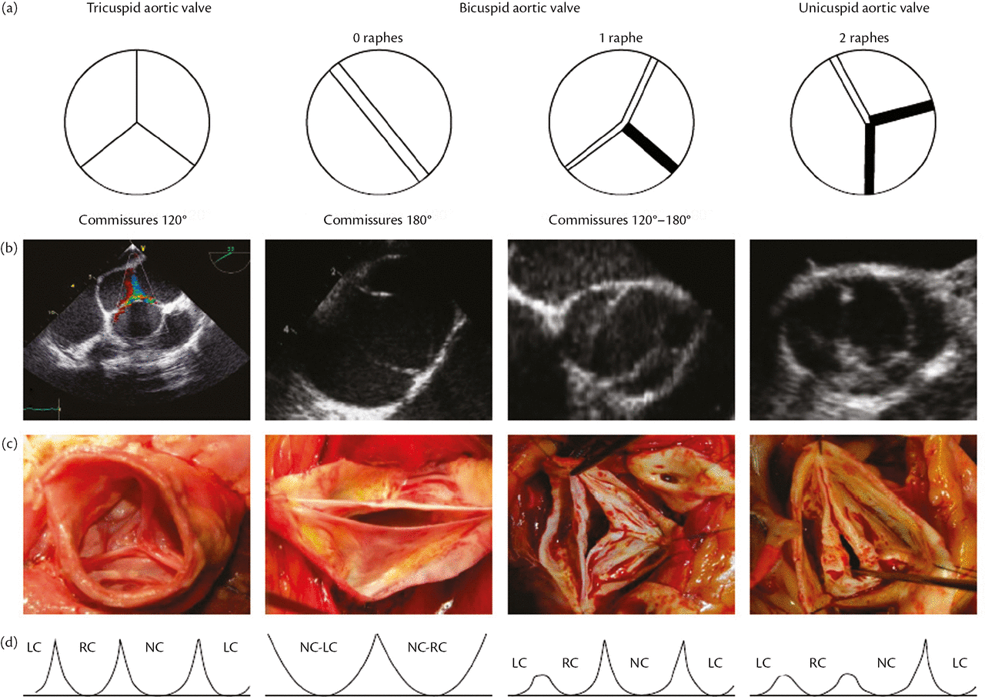

Slide 6
Bicuspid aortic valve
Bicuspid aortic valves are the most common cardiac valvular anomaly, occurring in 1- 2% of the general population.
It is twice as common in males as in females.

Slide 7
MAIN Causes of Aortic Regurgitation
Leaflet abnormalities | Aortic root or ascending aorta
Rheumatic fever | Systemic hypertension
Endocarditis | Aortitis (eg, syphilis)
Trauma
Bicuspid aortic valve | Ankylosing spondylitis
 | Trauma/ Dissecting aneurysm
 | Marfan syndrome/ EDS
 | Inflammatory bowel disease
AR is seen more commonly in men than in women.

Slide 8
Valvular Abnormalities
Rheumatic Disease
Aortic Root Dilation
Endocarditis

Slide 9
Pathophysiology of chronic AR
AR leads to increased end diastolic volume of LV
To accommodate this regurgitant volume LV compliance increases so there is augmented LVEDV.
There is increase in total stroke volume resulting in forward stroke volume within normal range (starling law)
In addition to increase in compliance, ventricle produces new sarcomers in sereies leading to eccentric hypertrophy.
In AS concentric LVH occurs as the sarcomeres replicate in parallel

Slide 10
Aortic Regurgitation Pathophysiology

Slide 11
Aortic Regurgitation Pathophysiology

Slide 12
Pathophysiology of chronic AR
As a result of maintenance of normal LV systolic function and normal forward stroke volume despite the increase in LV diastolic volume, most patients with chronic AR remain asymptomatic for decades
As AR progresses, LV enlargement surpasses preload reserve on the Frank-Starling curve, with the EF falling to normal and then subnormal levels.
The LV end-systolic volume rises and is a sensitive indicator of progressive myocardial dysfunction.

Slide 14
Pathophysiology – Acute AR
Acute AR of significant severity leads to increased blood volume in the LV during diastole. The LV does not have sufficient time to dilate in response to the sudden increase in volume. As a result, LV end-diastolic pressure increases rapidly, causing an increase in pulmonary venous pressure and altering coronary flow dynamics. As pressure increases throughout the pulmonary circuit, the patient develops dyspnea and pulmonary edema.
In severe cases, heart failure may develop and potentially deteriorate to cardiogenic shock. Decreased myocardial perfusion may lead to myocardial ischemia.

Slide 15
Physical Examination – Acute AR
Tachycardia
Peripheral vasoconstriction
Cyanosis
Pulmonary edema
Arterial pulsus alternans; normal LV impulse
Early mitral valve closure
Early diastolic murmur (lower pitched and shorter than in chronic AR) may be present.
A murmur at the right sternal border is associated more often with dissection than it is with any other cause of aortic regurgitation.

Slide 16
Epidemiology
Approximately three-fourths of patients with pure or predominant valvular AR are men.
Chronic AR often begins in patients when they are in their late 50s. In general, the prevalence and severity of AR increase with age.
However, there are many exceptions to this observation. Patients with bicuspid aortic valve and, especially, those with Marfan syndrome tend to present much earlier

Slide 17
Clinical presentation of AR
SYMPTOMS OF CHF (MOST COMMON)
Exertional dyspnoea
Orthopnea
PND
Late--Right heart failure (pedal oedema, ascitis, hepatomegaly)

Slide 18
Clinical history
Palpitation
Angina
Less common
Dyspnoea
Initially on exertion
PND

Slide 19
Clinical presentation of AR
Most patients are asymptomatic for decades 10-15 yrs
Palpitations (it is awareness of forceful left ventricular contraction) Initial symptom due to vigrous contraction of volume overload LV
Non-specific chest pain
Angina (less common)
May be related to CAD
Or it may occur with normal coronaries (low diastolic pressure leads to decreased myocardial perfusion in the face of increased myocardial oxygen demand secondary to LVH)

Slide 20
Myocardial ischemia
Increase in wall tension – Increase in 02 demand
Decrease in diastolic pressure – coronary perfusion
pressure is reduced.
So increased O2 demand & decreased O2 supply sets mmyocardial ischemia

Slide 22
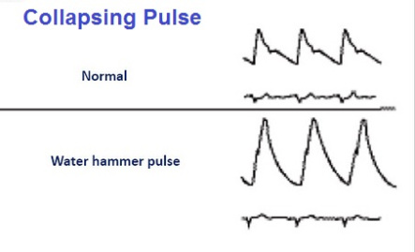

Slide 24
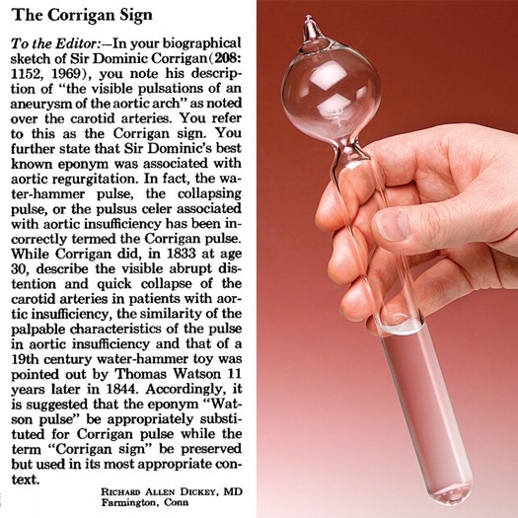

Slide 27
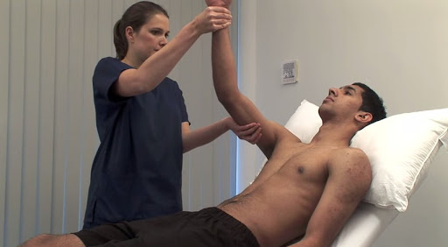
Patient is made to recline. The examiner raises the patient's arm vertically upwards and grasps the muscular part of the patient's forearm with the entire hand (the flexor aspect of the patient's forearm being covered with the examiner's palm, principally the thenar eminence). The water hammer pulse is felt as an impact (tapping , slapping pulse) through the bulk of the forearm muscles with the thenar eminence of the palpating hand. ^{[3]}
Method to Elicit the 'Water Hammer Pulse'

Slide 28
it is characterized by rapid upstroke ( percussion wave) followed by rapid descent ( collapse) of the pulse wave without dicrotic notch , which reflects low systemic vascular resistance.
– Rapid upstroke is due to the rapid ejection of greatly increased stroke volume . – the rapid descent or collapsing character is due to : a) diastolic “run-off” ( back flow) into the left ventricle b) reflex vasodilation mediated by carotid baroreceptors secondary to large stroke volume . c) the rapid run-off to the periphery due to decreased systemic vascular resistance .
Detection: It is best appreciated at the radial pulse with the palmer side of the patient’s wrist held in the examiner’s hand and with the patient’s arm suddenly elevated above the shoulder. This may be related to the artery becoming more in line with the central aorta, allowing direct systolic ejection and diastolic backward flow .

Slide 29
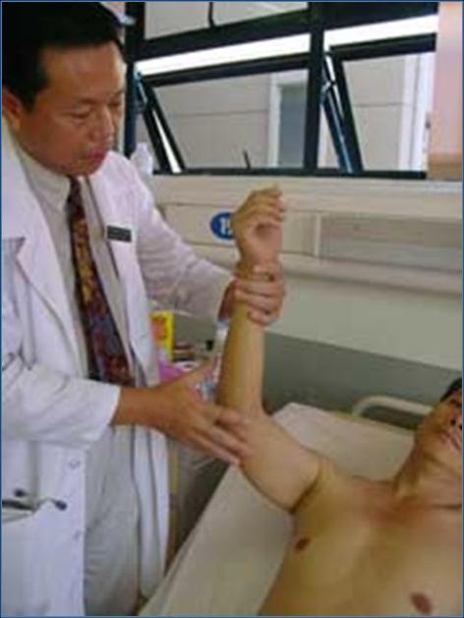
Thomas Watsan (1844) , an English physician , named this term after a Victorian toy , which refers to the rapid and forceful ascending limb of the arterial pulse . water-hammer consisted of a sealed glass tube containing water in a vacuum .
As solids and liquids fall at the same rate in vacuum , so when this glass tube is quickly inverted , water column falls abruptly from one end of the tube to the other and inger tip holding the inverted end senses a sudden impact or jolt .

Slide 30
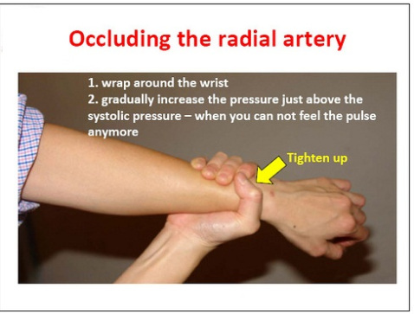
Again, as a self-learner now, you have to correlates it with objective measures. The objective measure for collapsing pulse is the pulse pressure. It is present when the pulse pressure is wide. But how wide is wide? A pulse pressure is wide whenever it is larger than the diastolic pressure. To maintain a constant grip throughout the procedure, I will advise you not to elevate the arm by your gripping hand. The arm is elevated by putting you right hand under patient’s elbow.

Slide 31
Physical Examination – Chronic AR
Manifestations of severe chronic AR are often the result of widened pulse pressure because (1) elevated stroke volume exists during systole and (2) the incompetent aortic valve allows the diastolic pressure within the aorta to fall significantly.
On palpation, the point of maximal impulse may be heaving or hyperdynamic but is often displaced inferiorly and toward the axilla. The systolic expansion and diatolic retraction are prominently seen.Peripheral pulses are prominent or bounding. Auscultation may reveal an S₃ gallop if LV dysfunction is present.
A diastolic thrill may be palpable along the left sternal border in thin-chested individuals, and a prominent systolic thrill may be palpable in the suprasternal notch and transmitted upwards along the carotids .

Slide 32
Auscultation
The murmur of aortic regurgitation is a soft, high-pitched, early diastolic decrescendo murmur heard best at the 3rd intercostal space on the left (Erb's point) on end expiration, with the patient sitting up and leaning forward. The duration of the murmur correlates better with the severity of AR than does the loudness of the murmur.
When the murmur is musical (cooing dove murmur), it usually signifies eversion or perforation of an aortic cusp vibrating in jet of regurgitant stream of AR
Harvey sign - When regurgitation is caused by primary valvular disease, the diastolic murmur is heard best along the left sternal border in the 3rd and 4th ICS.
When it is caused mainly by dilation of the ascending aorta, the murmur is often more readily audible along the right sternal border

Slide 33
Auscultation
A functional systolic flow murmur may also be present
An Austin-Flint murmur may be present at the cardiac apex in severe AR; it is a low-pitched, mid-diastolic rumbling murmur due to blood jets from the AR striking the anterior leaflet of the mitral valve, which results in diastolic displacement of and premature closure of the mitral leaflets.it is not associated with hemodynamic significant mitral obstruction.
In addition to the above murmur, a mid systolic systolic ejection murmur may be present at the right upper sternal border simply due to the large stroke volume passing through the aortic valve with each LV systolic contraction.this murmur may be quite loud with out signifying aortic stenosis.
A₂ may be normal or accentuated when AR is caused by disease of the aortic root but is soft or absent when the valve is causing AR. P₂ may be obscured by the early diastolic murmur.

Slide 34
Auscultation
A third heart sound (S₃) correlates with an increased LV end-diastolic volume. Its development may be a sign of impaired LV function, which is useful in identifying patients with severe AR who are candidates for surgical treatment.
The auscultatory features of AR are intensified by strenuous and sustained handgrip, which augments systemic vascular resistance.

Slide 35
Peripheral Signs
Becker sign - Visible systolic pulsations of the retinal arterioles
Corrigan pulse ("water-hammer" pulse) - Abrupt distention and quick collapse on palpation of the peripheral arterial pulse
de Musset sign - Bobbing motion of the patient's head with each heartbeat
Hill sign – (Popliteal cuff systolic blood pressure 20 mm Hg higher than brachial cuff systolic blood pressure) is an artifact of sphygmomanometric measurements and is no longer considered a sign of severe AR.
Duroziez sign - Systolic murmur over the femoral artery with proximal compression of the artery, and diastolic murmur (Duroziez murmur) over the femoral artery with distal compression of the artery

Slide 36
Müller sign - Visible systolic pulsations of the uvula
Light-house sign – Alternate flushing & blanching of forehead
Landolfi’s sign - Change in pupil size with each systole
Gerhardt’s sign - Visible systolic pulsations of spleen
Rosenbach’s sign - Visible systolic pulsations of liver
Corrigan’s sign – Dancing carotid in neck
Quincke sign - Visible pulsations of the fingernail bed with light compression of the fingernail
Traube sign ("pistol-shot" pulse) - Booming systolic and diastolic sounds auscultated over the femoral artery
A bisferiens pulse in AS + AR – readily recognized in the brachial and femoral arteries than in the carotid arteries.(Two systolic waves separated by a trough )

Slide 38
Assessing Severity of AR
Assess severity by impact on peripheral signs and LV
peripheral signs positive = severity
LV Dysfunction S3 present= severity
Long duration of diastolic murmur= severity, longer , louder and indeed holodiastolic in severe cases.
Austin –Flint murmur= severity
LVH
radiological cardiomegaly

Slide 39
Differential Diagnosis
Hyperdynamic circulation (wide pulse pressure), including the following:
Thyrotoxicosis
Severe anemia
Pregnancy
Thiamine deficiency (wet beriberi)
Arteriovenous fistula - Such as patent ductus arteriosus or peripheral arteriovenous malformations
Volume depletion
Sympathetic overdrive

Slide 40
ECG
LV hypertrophy
Left axis deviation
Left atrial enlargement
LV volume overload pattern - Prominent Q waves in leads I, aVL, and V₃ to V₆ and relatively small r waves in V₁
LV conduction defects - Typically late in the disease process
poor prognosis.

Slide 41
The patient’s 12-lead electrocardiogram shows normal sinus rhythm and a rate of 55 beats per minute. The frontal-plane QRS complex vector is deviated leftward. Left atrial abnormality is present, given the terminally negative P wave in lead V₁ and the bifid P wave in lead II. Left ventricular volume overload is supported by the following findings: increased QRS complex voltage, best seen in the precordial (chest) leads, indicative of increased left ventricular mass;

Slide 42
Chest X-Ray
In acute AR, there may be minimal cardiac enlargement, but marked enlargement is a common finding in chronic AR.
The apex is displaced downward and to the left in the frontal projection. In the left anterior oblique and lateral projections, the LV is displaced posteriorly and encroaches on the spine.
Distinct left atrial enlargement in the absence of heart failure suggests associated mitral valve disease.
When AR is caused by primary disease of the aortic root, aneurysmal dilation of the aorta may be noted, and the aorta may fill the retrosternal space in the lateral view.

Slide 43
Aortic Regurgitation CxR
Chronic
Acute
LVE with normal pulmonary vasculature
Normal size LV with pulmonary vascular congestion

Slide 44
Echocardiography
Aortic valve structure and morphology - Bileaflet versus
trileaflet, flail, thickening
Presence of vegetations or nodules - May require transesophageal echocardiography in selected cases
Severity of AR
Color Doppler central jet width & Vena contracta (narrowest portion of the jet located at or just distal to its orifice) width –
In severe AR, the vena contracta width is usually more than 65% of the width of the LV outflow tract
Regurgitant volume, fraction, and orifice area is calculated
abdominal aorta

Slide 46
AMVL fluttering
Color Flow – top mild, bottom moderate

Slide 47
Cardiac MRI
CMR provides accurate measurements of regurgitant volumes and the regurgitant orifice in AR. It is the most accurate noninvasive technique for assessing LV end- systolic volume, diastolic volume, and mass

Slide 48
Management – Acute AR
Prompt surgical intervention is indicated-24-48 hrs
Administer a positive inotrope (eg, dopamine,
dobutamine) and a vasodilator (eg, nitroprusside).
Administration of vasodilators may be appropriate to improve systolic function and to decrease afterload.
Beta-blocking agents and intra-aortic balloon counterpulsation are contraindicated, because either lowering the heart rate or augmenting peripheral resistance during diastole can lead to rapid hemodynamic decompensation.

Slide 49
Management – Chronic MR
The current ACC/AHA guidelines say the following about
vasodilator therapy (Nifedipine, ACE Inhibitors):
Vasodilator therapy is indicated for long-term treatment in patients who have severe chronic AR and symptoms of LV dysfunction but who are not candidates for surgery.
Vasodilator therapy is reasonable for short-term therapy in patients with severe LV dysfunction and heart failure symptoms, in order to improve their hemodynamic profile before surgery( bridge therapy)
Vasodilator therapy is acceptable for long-term therapy in asymptomatic patients with severe AR and LV dilation with normal EF

Slide 50
Management – Chronic MR
SURGIAL MANAGEMENT
SEVERE AR ON ECHO –SYMPTOMATIC= AVR,
-ASYMPTOMATIC= AVR
LVEF<50%,
LVESD>50mm,
LVEDV>65mm
PROGRESSIVE AR –ASYMPTOMATIC, LV FUNCTIONS
NORMAL=MONITOR EVERY 6 MONTHS.
SUREGY INDICATED AS SOON AS LVEF,50%, EVEN WITH OUT SYMPTOMS OF DYSPNEA
ISOLATED AVR MORTALITY -2%, BUT INCREASES UP TO 10% AS THE LV DYSFUNCTION INCREASES.

Slide 51
Patient is symptomatic.
Patient is asymptomatic, with a resting EF of ≤ 55%.
Patient is asymptomatic, with LV dilation (LV end-systolic dimension >55 mm).

Slide 52
Figure A. Björk-Shiley Monostrut mechanical prosthesis. B. Sorin Allcarbon monoleaflet mechanical prosthesis.
C. Medtronic-Hall mechanical prosthesis.
Figure 29-16 A. Carpentier-Edwards Supra- annular porcine bioprosthesis. B. Hancock II porcine bioprosthesis. C. Hancock modified orifice porcine bioprosthesis. D. St. Jude porcine bioprosthesis
D. Omnicarbon mechanical prosthe tic.

Slide 53
Transcatheter aortic valve replacement
TAVR involves the implantation of a bioprosthetic aortic valve using a catheter that is inserted peripherally, typically through the femoral artery, and implanted without requiring a median sternotomy (ie, without ―open heart surgery‖). It is being used commonly now in suitable patients.
If MS + AR, first go for AR as correcting MS will increase LV load → LVF.

Slide 54
Prognosis
Death usually occurs within 4 yrs after onset of angina pectoris and within 3 yrs of onset of heart failure
It is imperative to intervene before irreversible LV dysfunction occurs.
After AVR, Long term results reveal 80-90% three year survival in patients with preserved LV function, and 40- 60% three year survival in patients with poor LV function.
Mortality rate of AVR ranges from 2-10 %

Slide 55
Thank You
freemeditation.com
drsandeeprai.com

Slide 56
Summary

Slide 64
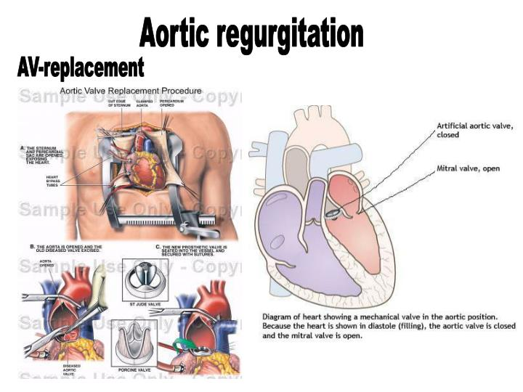

Slide 65
