Slide 1
CAD-MI
DR. SANDEEP RAI
PROFESSOR & UNIT HEAD
POST GRADUATE DEPARTMENT OF MEDICINE
MGM INSTITUTE OF HEALTH SCIENCES
NAVI MUMBAI

Slide 2
Cardio-Vascular Disease
Coronary Artery Disease:
Atheroscelorsis, Angina, Myocardial Infarction
Dr. Sandeep Rai

Slide 4
Ischemic heart disease
Also known as Coronary Artery Disease (CAD)
Ischemic heart disease (IHD) is a condition in which there is an inadequate supply of blood and oxygen to a portion of the myocardium
Imbalance between myocardial oxygen supply
and demand.
Caused mainly by Atherosclerosis of Coronary Artery
It includes
Angina: Stable & Unstable
Myocardial infarction, STEMI, NSTEMI

Slide 5
Etiology
Atherosclerosis is the disease primarily responsible for most acute coronary syndrome (ACS) cases.
Approximately 90% of myocardial infarctions (MIs) result from an acute thrombus that obstructs an atherosclerotic coronary artery.
Plaque rupture and erosion are considered to be the major triggers for coronary thrombosis.
Following plaque erosion or rupture, platelet activation and aggregation, coagulation pathway activation, and endothelial vasoconstriction occur, leading to coronary thrombosis and occlusion.

Slide 6
MI can also occur for causes other than atherosclerosis. Nonatherosclerotic causes of MI include the following
:
Coronary occlusion secondary to VASCULITIS
Ventricular hypertrophy (eg, left ventricular hypertrophy, hypertrophic cardiomyopathy)
CORONARY ARTERY EMBOLI, secondary to cholesterol, air, or the products of sepsis
Coronary trauma
Primary coronary vasospasm (variant angina)
DRUG USE (EG, COCAINE, amphetamines, ephedrine)
Arteritis
Coronary anomalies, including ANEURYSMS OF CORONARY ARTERIES
Factors that increase oxygen requirement, such as heavy exertion, fever, or hyperthyroidism
Factors that decrease oxygen delivery, such as hypoxemia of severe anemia
Aortic dissection, with retrograde involvement of the coronary arteries

Slide 9
Atherosclerosis
Can affect any artery in the body
Heart: angina, MI and sudden death;
Brain: stroke and transient ischaemic attack;
Limbs: claudication and critical limb ischaemia.

Slide 10
Early Atherosclerosis
Second and third decades of life
Tend to occur at sites of altered arterial shear stress such as
bifurcations
Starts with any abnormal endothelial function
Inflammatory cells, predominantly monocytes, bind to receptors expressed by endothelial cells,
Migrate into the intima
Take up oxidised low-density lipoprotein (LDL) particles
Become lipid-laden macrophages or FOAM CELLS.
As Foam cells dies, it releases its lipid pool in intimal space with
cytokines and growth factor
In response, smooth muscle cells migrate from the media of the arterial wall into the intima
Lipid core will be covered by smooth muscle cells and matrix
Forms stable atherosclerotic plaque that will remain asymptomatic until it becomes large enough to obstruct arterial flow

Slide 11
Advanced Atherosclerosis
In established atherosclerotic plaque, macrophages mediate inflammation and smooth muscle cells promote repair
Cytokines released by macrophage starts degrading smooth muscle layered over plaque
Now lesion remains vulnerable to mechanical stress that ultimately causes erosion, fissuring or rupture of the plaque surface.
Any breach in the integrity of the plaque will expose its contents to blood
Trigger platelet aggregation and thrombosis
That extend into the atheromatous plaque and the arterial lumen.
cause partial or complete obstruction at the site of the lesion
distal embolisation resulting in infarction
ischaemia of the affected organ

Slide 17
Early Atherosclerosis

Slide 24
Advanced Atherosclerosis

Slide 25
Risk factor of Atherosclerosis
Effect of risk factors is multiplicative rather than
additive.
It is important to distinguish between relative risk and absolute risk.
Absolute Risk
Age
Male sex
Positive family history

Slide 26
Risk factor of Atherosclerosis
Relative Risk
Smoking
Hypertension
Diabetes mellitus
Haemostatic factors.
Physical activity
Obesity
Alcohol
Other dietary factors
Personality
Social deprivation

Slide 27
Risk factor: Absolute Risk
Age & Sex
Premenopausal women have lower rates of disease than men
Although this sex difference disappears after the
menopause
Positive family history
Runs in families,
Due to a combination of shared genetic, environmental and lifestyle factors.

Slide 28
Risk factor: Relative Risk
Smoking
strong consistent
Dose linked relationship between cigarette smoking and IHD, especially in younger (< 70 years) individuals
Hypertension: directly proportional
Hypercholesterolaemia: directly proportional to serum cholesterol concentrations (LDL)
Diabetes mellitus: potent risk factor for all forms of atherosclerosis
Men with type 2 diabetes: two- to four-fold greater annual risk
of CAD,
Women with type 2 diabetes: (3–5-fold) risk

Slide 29
Risk factor: Relative Risk
Haemostatic factors
Platelet activation and high levels of fibrinogen
Antiphospholipid antibodies - recurrent arterial thromboses
Physical activity
Physical inactivity roughly doubles the risk of coronary heart
disease
Regular exercise
Increased serum HDL cholesterol concentrations,
Lower BP,
Collateral vessel development
Obesity: often associated with HTN and cardiovascular disease

Slide 30
Risk factor: Relative Risk
Alcohol: excess consumption
Other dietary factors
Diets deficient in fresh fruit, vegetables and
polyunsaturated fatty acids (PUFA)
Personality: little or no evidence to support the popular belief that stress is a major cause of CAD
Social deprivation

Slide 31
Primary Prevention
Strategies taken before onset of disease in high risk individual.
Two complementary strategies
Population strategies
modify the risk factors of the whole population
through diet and lifestyle advice
For ex: Public restricting of smoking
Targeted strategies
identify and treat high risk individuals who usually have a combination of risk factors
can be identified by using composite scoring system

Slide 32
Secondary Prevention
Already have evidence of atheromatous vascular disease are at high risk of future cardiovascular events.
Various secondary measures in this case
energetic correction of modifiable risk factors,
Smoking
Hypertension
Hypercholesterolaemia,
Statin therapy irrespective of their serum cholesterol concentration
Target BP of ≤ 140/85 mmHg
Aspirin and ACE inhibitors
Beta-blockers: h/o MI or heart failure.

Slide 38
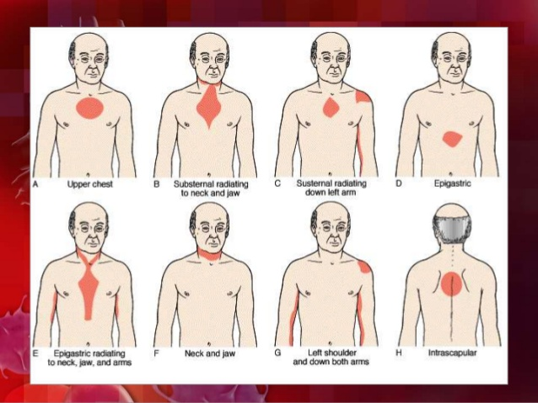

Slide 41
ISCHEMIC HEART DISEASES
INTRODUCTION
CHRONIC ARTERY DISEASES
ACUTE CORONARY SYNDROME

Slide 44
HISTORY AND PHYSICAL EXAMINATION
CHEST DISCOMFORMT
IF LARGE AREA ISCHEMIA AND
LARGE NSTEMI
Often severe enough to be describe as frank pain
Located substernal or epigastric
Radiates to left arm, left
shoulder, and neck
Anginal equivalence may occur instead chest discomform
Resemble stable angina
Diaphoresis
Pale
Cool skin
Sinus tachycardia
Third or fourth heart sound
Rales
Hyotension

Slide 45
Acute MI
DR. SANDEEP RAI
PROFESSOR & UNIT HEAD
POST GRADUATE DEPARTMENT OF MEDICINE
MGM INSTITUTE OF HEALTH SCIENCES
NAVI MUMBAI

Slide 46
Acute Coronary Syndrome
Present as a new phenomenon or against a background of chronic stable angina.
Complex ulcerated or fissured atheromatous plaque with adherent platelet rich thrombus and local coronary artery spasm.
Dynamic process: degree of obstruction may either increase or regress
Without treatment, the infarct-related artery remains permanently occluded in 20–30% of patients

Slide 47
Acute Coronary Syndrome
It consist of
Myocardial Infarction: ST-elevation myocardial infarction (STEMI) or Non-ST-elevation myocardial infarction (NSTE MI) NSTE ACS
symptoms occur at rest
evidence of myocardial necrosis - increased cardiac troponin or Creatine kinase-MB isoenzyme
Unstable angina (UA).
new-onset or rapidly worsening angina (crescendo angina),
angina on minimal exertion
or angina at rest in the absence of myocardial damage

Slide 48
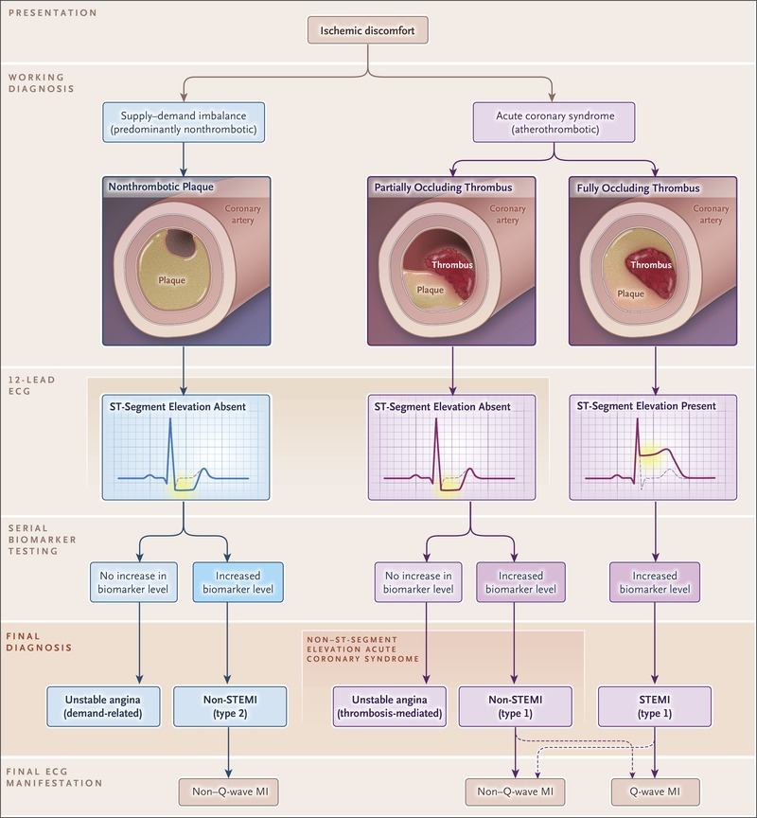

Slide 52
Clinical features : Symptoms
Pain is the cardinal symptom
Prolonged cardiac pain: chest, throat, arms, epigastrium or back
Anxiety and fear of impending death
Nausea and vomiting
Breathlessness
Collapse/syncope

Slide 53
PHYSICAL SIGNS
Signs of vagal activation
Vomiting
Bradycardia
Sign of tissue damage
Fever
Signs of complication
Mitral regurgitation
pericaritis
Signs of sympathetic activation
Pallor
Sweating
Tachycardia
Signs of impaired myocardial function
Hypotension, oliguria, cold peripheries
Narrow pulse pressure
Raised jvp
Third heart sound
Diffuse apical impulse
Lung crepitations

Slide 55
The third universal definition
of myocardial infarction
Myocardial infarction (MI), commonly known as a heart attack, is defined pathologically as the irreversible death of myocardial cells caused by ischemia.
Clinically, MI is a syndrome that can be recognized by a set of symptoms, chest pain being the hallmark of these symptoms in most cases, supported by biochemical laboratory changes, electrocardiographic (ECG) changes, or findings on imaging modalities able to detect myocardial injury and necrosis.

Slide 56
Universal definition of Myocardial Infarction (MI)))
According to the third universal definition of MI, implemented by a joint task force from the European Society of Cardiology (ESC), American College of Cardiology (ACC) Foundation, American Heart Association (AHA), and the World Heart Federation (WHF), MI is diagnosed when either of the following two criteria are met.
Detection of an increase in cardiac biomarker values (preferably using cardiac troponin [cTn]) with at least one value above the 99th percentile of the upper reference limit (URL) and
with at least one of the following findings:
Symptoms of ischemia
New or presumed new significant ST-segment-T wave (ST-T) changes or new left bundle branch block (LBBB)
Development of pathologic Q waves on the ECG
Imaging evidence of new loss of viable myocardium or a new regional wall motion abnormality
Identification of an intracoronary thrombus by angiography or autopsy

Slide 57
The Joint ESC/ACCF/AHA/WHF Task Force further classified MI into 5 types on the basis of the underlying cause :
Type 1 (spontaneous MI): Related to atherosclerotic plaque rupture, ulceration, fissuring, erosion, or dissection with intraluminal thrombus in one or more of the coronary arteries, leading to decreased myocardial blood flow or distal platelet emboli and thereby resulting in myocyte necrosis. The patient may or may not have underlying obstructive coronary artery disease (CAD).
Type 2 (MI secondary to an ischemic imbalance): MI consequent to increased oxygen demand or a decreased supply (eg, coronary endothelial dysfunction, coronary artery spasm, coronary artery embolus, tachyarryhthmias/bradyarrhythmias, anemia, respiratory failure, hypertension, or hypotension).
Type 3 (MI resulting in death when biomarker values are unavailable): Sudden, unexpected cardiac death before blood samples for biomarkers could be drawn or before their appearance in the circulation.

Slide 58
Type 4a (MI related to percutaneous coronary intervention [PCI]): Elevation of biomarker values (cTn is preferred) to more than 5 times the 99 ^{th} percentile of the URL in patients with normal baseline values (< 99 ^{th} percentile URL) or a rise of values over 20% if the baseline values are elevated but stable or falling. In addition, any of the following are required: (1) symptoms suggestive of myocardial ischemia; (2) new ischemic ECG changes or new BBB; (3) angiographic loss of patency of a major coronary artery or a side branch or persistent slow flow or no flow or embolization; or (4) demonstration of the new loss of viable myocardium or new regional wall motion abnormality by cardiac imaging.
Type 4b (MI related to stent thrombosis): MI associated with stent thrombosis as detected by coronary angiography or autopsy in the setting of myocardial ischemia in combination with a rise and/or fall of cardiac biomarkers with at least one value above the 99 ^{th} percentile URL.
Type 5 (MI related to coronary artery bypass grafting [CABG]): Elevation of cardiac biomarker values more than 10 times the 99 ^{th} percentile URL in patients with normal baseline cTn values. In addition, either (1) new pathologic Q waves or new BBB, (2) angiographic-documented new graft or native coronary artery occlusion, or (3) evidence of new loss of viable myocardium or new regional wall motion abnormality by cardiac imaging is required.

Slide 59
STEMI
Definition of STEMI – New ST elevation at the J point in two contiguous leads of >1 mm in all leads in absence of left ventricular hypertrophy or left bundle branch block, other than leads V2-V3 – For leads V2-V3 the following cut points apply: ≥2 mm in men ≥40 years, ≥1.5 mm in women.
STEMI is a life-threatening, time-sensitive emergency that must be diagnosed and treated promptly

Slide 62
CARDIAC MARKER

Slide 63
CARDIAC BIOMARKER
Patient with STEMI elevated biomarker
Troponin T troponin I (TnT, TnI)
Specific and sensitve
Preferred for myocardial necrosis
Ck-MB isoform
Less sensitive alternative
Distinguish patient with STEMI AND UA
Temporal rise and fall of this plasma concentration marker and has a directlv relationship between elevation and mortality

Slide 64
CKMB | TIME
RISE | 4-6 HR
PEAK | 12 HR
DIASSAP]REA | 48-72 HR
TROP T AND TROP I | TIME
RISE | 4-6 HR
REMAIN ELEVATED | 2 WEEKS

Slide 70
DIAGOSTIC EVAUTAION
In addition to clinical examinatiom
ECG
Cardiac biomarker
Stress testing
CCTA
A 62-year-old man presented for coronary CT angiography (CCTA) due to chest pain. Free- breathing prospective CCTA images show the clearly defined coronary arteries with calcified plaque (arrows) without motion artifacts. All images courtesy of Dr. Eun-Ju Kang.
Goals
Recognize or exclude MI
Detect rest ischemia
Signify coronary artery obstruction

Slide 71
INVESTIGATION

Slide 72
ELECTROCARDIOGRAM
Should be done and interpreted within few minutes of arrival
12 lead ECG ;
3 Standard limb lead (I, II, III)
3 Augmented limb lead (aVR, aVL, aVF)
6 precordial limb lead (V1 – V6)

Slide 73
ELECTROCARDIOGRAM

Slide 74
ELECTROCARDIOGRAM
New ST elevation at the J point in two anatomical contiguous leads of >1mm in all leads in absence of left ventricular hypertrophy or left budle branch block, other than leads V2-V3 – For leads V2-V3 (precordial lead) the following cut points apply: ≥2 mm in men ≥40 years, ≥1,5 mm in women.
In early MI, T waves become tall ( hyperacute myocardial infarction), transient and last for few hours only.
Q wave formation

Slide 75
ECG AND LOCATION OF MI

Slide 77
SHOWS ST ELEVATION BUT NOT STEMI !
E lectrolyte abnormalities
L eft bundle branch block A neurysm of left ventricle V entricular hypertrophy
A rrhythmia disease (Brugada syndrome, ventricular tachycardia)
T akotsubo/Treatment (iatrogenic pericarditis) Injury (MI or cardiac contusion)
O sborne waves (hypothermia or hypocalcemia)
N on-atherosclerotic (vasospasm or Prinzmetal’s angina

Slide 78
The Laboratory Diagnosis of STEMI is
done by :
◆ Cardiac Troponin
The most sensitive and specific marker of myocardial necrosis.
◆ CK-MB
◆ Myoglobin

Slide 79
CARDIAC MARKER

Slide 80
PROPERTIES OF CARDIAC MARKER
CreatineMIKinase MB is less sensitive and specific for the diagnosis ofMI.However, it remains useful for the diagnosis of early infarctextension (reinfarction) and peri-procedural MI because of itsshort half life. NT-Pro BNP is helpful in assessing left ventricular failure patients.

Slide 81
Causes of Serum Troponin T and I Elevations,
Including Both ACS, Non Coronary Events and Non Cardiac Events
◆ Acute Myocardial Infarction
◆ Shock of any form (Cardiogenic, Obstructive, Distributive)
◆ Myocarditis and Myopericarditis
◆ Cardiomyopathies
◆ Acute Congestive Failure (Pulmonary Edema)
◆ Sepsis
◆ Pulmonary Embolism
◆ Renal Failure
◆ Burns
◆ Acute CNS Event
◆ Rhabdomyolysis
◆ Cardiiac Neoplasm, Inflammatory Syndromes, Infiltrative Diseases
◆ Sympathomimetic Ingestions
◆ Congenital Coronary Anomalies
◆ Extreme Physical Exertion

Slide 82
Investigations
Other blood tests: erythrocyte sedimentation rate (ESR) and C- reactive protein (CRP) are also elevated
Chest X-ray
pulmonary oedema that is not evident on clinical examination
heart size is often normal
But there may be cardiomegaly due to pre-existing myocardial
damage
Echocardiography
assessing left and right ventricular function
detecting important complications such as
mural thrombus,
cardiac rupture,
ventricular septal defect,
mitral regurgitation and
Pericardial effusion.

Slide 83
ECHOCARDIOGRAM (ECHO)
To detect the presence or absence of wall motion abnormalities and value of ejection fraction

Slide 84
LATE ENHANCEMENT MAGNETIC RESONANCE IMAGING ( MRI )
The most accurate method for diagnosing MI or nonischemic cardiomyopathies, quantifying the scar, assessing viability and evaluating thrombus
Hyperenchancement is seen as bright area of tissue against background of dark normal myocardium
Gadolinium is administered, images obtained after 10 mins

Slide 86
OTHERS
Leukocytosis with a peak on 1st day
Raised ESR that remain for some days
Elevated C- reactive protein
Chest radiography
Heart size usually normal
Enlargement cardiac shadow indicate previous myocardial damage or pericardial effusion
Evidence of pulmonary edema
Radionuclide scanning
Shows site of necrosis and extent of impairment of ventricular function (lack of sensitivity and specificity)

Slide 87
PREHOSPITAL CARE
Specific prehospital care includes the following:
Intravenous access, SUPPLEMENTAL OXYGEN if the oxygen saturation (SaO₂) is less than 90%, pulse oximetry
Immediate administration of nonenteric-coated chewable ASPIRIN en route
Nitroglycerin for active chest pain, given sublingually or by spray.Sublingual nitroglycerine up to 3 doses of 0.4mg at 5 minutes interval
Telemetry and prehospital ELECTROCARDIOGRAPHY (ECG), if available
Most deaths caused by MI occur early and are attributable to primary ventricular fibrillation (VF). Therefore, initial objectives are immediate ECG monitoring; electric CARDIOVERSION IN CASES OF VF; and rapid transfer of the patient to facilitate prompt coronary assessment.
Prehospital integration of ECG interpretation has been shown to decrease "door-to-balloon time,” allow paramedics to bypass non–percutaneous coronary intervation (PCI)–capable hospitals in favor of PCI-capable facilities

Slide 88
Management
◆ Early and Emergency Medical Management :
Cardiac Monitoring
Oxygen
IV Access and Blood for U&E, Glucose, CBC, Cardiac Enzyme
Brief History and Clinical Assessment
Loading Dose of Aspirin and Clopidogrel
Analgesia if Continuing Pain
Antiemetic and Anxiolytic if required
Reperfusion Therapy / Thrombolytic Therapy

Slide 89
In-Hospital Care
Within the first 10 minutes that the patient is in the emergency department (ED), work through the following:
Check vital signs.
Evaluate oxygen saturation. Supplemental oxygen by a mask or nasal cannula is indicated only for patients who are breathless, hypoxic (oxygen saturation < 90% or PaO₂< 60 mm Hg ),
or who present with heart failure.
The use of oxygen in patients with acute MI who don’t fall into one of the three above-mentioned categories remains uncertain, with some studies suggesting possible harm in such patients
nutes).

Slide 90
Establish IV access.
Obtain or review a 12-lead ECG (if not established in the field).
Look for risk factors for ACS, cardiac history, signs and symptoms of heart failure by taking a brief, targeted history.
Perform a physical exam.
Obtain a portable x-ray (less than 30 mi

Slide 91
Initial Treatment
The first treatment that should be given is 325 mg of (preferably)
NON ENTERIC-COATED ASPIRIN to be chewed.
All patients should receive aspirin unless there is a clear history of aspirin allergy. Even Asprin Intolerant pts should be given Asprin
Chewable aspirin is preferred, as this promotes rapid absorption into the bloodstream to achieve faster therapeutic levels. DISPRIN TAB.
Pts unable to swallow can be given 300 mg suppositoy or 80 -150 iv.
A lifelong maintenance dose of (75 to 81 mg) daily should be prescribed to all patients after STEMI.

Slide 92
Analgesia
Essential not only to relieve distress, but also to lower adrenergic drive
IV opiates: initially morphine sulphate 3- 5 mg diluted or diamorphine 2.5–5 mg). It relieves pain, allays anxiety.
It causes dilatation of veins which decreases preload which decreases both Ischemia and pul edema.
IV Antiemetics: initially metoclopramide 10mg
Intramuscular injections should be avoided
Poor skeletal muscle perfusion
Painful haematoma

Slide 93
Analgesia
All patients should receive medications to relieve pain. These may include opioid analgesics (MORPHINE SULFATE INTRAVENOUSLY) where available. Refractory or severe pain should be treated symptomatically with IV morphine
.
The initial dose of morphine of 3to 5mg as an IV bolus can be given, with increments of 2 to 4 mg repeated every 5 to 10 minutes until the pain is relieved .Maxe is 30 mg. If large amounts not relieving pain suspect Aortic Dissection.
TOXICITY is manifested by hypotension, vomiting, or depressed respiration. Should toxicity occur, a morphine antagonist such as NALOXONE is used for reversal. 0.1 mg iv to be repeated every 10 mins.Morphine can cause brady cardia which should be releivered with 0.5 mg atropine.
The use of other analgesic agents, such as nonsteroidal anti-inflammatory drugs (NSAIDs) should be avoided if at all possible, as the use of these agents has been associated with adverse cardiovascular events

Slide 94
Anti-anginal Therapy
Sublingual glyceryl trinitrate (300–500 μg): valuable first-aid measure
Sublingual 0.3 -0.4 mg or intravenous nitrates should be administered if systolic blood pressure is ≥100 mm Hg.
Nitrates are potent vasodilators, and they act mainly to relax the arterial and venous system. Systemic venodilation results in reduction of venous blood return to the heart (ie, reducing the ventricular preload); this will lead to reduction of the workload of the heart, less oxygen demand, and reduction in ischemic pain.
Nitrates are also the most commonly used agents to reduce cardiac chest pain related to ischemia via coronary vasodilation.
So it decrease ischemia and heart failure both.

Slide 95
Anti-anginal Therapy
The most common side effect of nitrates are hypotension and headache.When chest pain persists or recurs,or pt is in heart failure iv nitrates are indicated, usually started at a dose of 5 to 10 µg/min and gradually increased until relief of chest pain is achieved.Max is 300 micogrms per minute.
Nitrates should not be used in patients presenting with marked hypotension or bradycardia, or if there is suspicion of right ventricular infarction.It is also
Special attention should be made in taking the history of whether concomitant use of phosphodiesterase (PDE) inhibitors (eg, sildenafil) has occurred within the last 24 to 72 hours, because this drug combination may lead to life-threatening hypotension.
.

Slide 96
Compound | Route | Dosage | Time of onset
Nitroglycerine, GTN | IV | 5 – 200 µg/minute* | 1 minute
 | Sublingual | 0.3 - 0.6 mg, can repeat up to 3 times at 5 minute intervals | 2 minutes
 | GTN spray | 0.4 - 0.8 mg per metered dose, no more than 3 sprays at 5 minute intervals | 2 minutes
 | Transdermal patch | 0.2 - 0.8 mg over 12 hours on, then 12 hours off | 1 - 2 hours
Isosorbide dinitrate | IV | 1.25 – 5 mg/hour | 1 minute
 | Transdermal patch | 2.5 – 10 mg | 3 - 4 minutes
 | Oral | 10 – 20 mg, bd/tds | 30-60 minutes
Isosorbide mononitrate extended release | Oral | 30-60 mg, od | 60 minutes
*The dose of IV nitrates should be titrated every 5 - 10 minutes until symptoms and/or ischaemia is relieved and the desired haemodynamic response is obtained.

Slide 97
ANTIPLATELET AGENTS
Other antiplatelet agents used for dual antiplatelet therapy are the P2Y₁₂ receptor inhibitors (eg, clopidogrel, ticagrelor, prasugrel); a loading dose of these agents is given before or at the time of reperfusion and an extended duration maintenance dose is administered thereafter, depending on the method of reperfusion.
For patients undergoing primary PCI, a loading dose of 600 mg of clopidogrel, 180 mg of ticagrelor, or 60 mg of prasugrel should be given as early as possible or at the time of primary PCI.
A maintenance dose of P2Y₁₂ receptor inhibitors should be continued for at least 1 year for patients who receive a stent, either a BMS or a DES. A daily dose of 75 mg clopidogrel, is recommended.

Slide 98
. For patients who receive fibrinolytic therapy, a loading dose of clopidogrel 300 mg
Introducing ticagrelor after myocardial infarction in patients with previous ischemic stroke is associated with lower rates of recurrent ischemic stroke, without an increase in intracranial bleeding.Ticagrelor CAUSES less bleeding compared to clopdrogel
Prasugrel is more potent than clopidrogel but The use of prasugrel is not recommended for patients with a history of stroke or transient ischemic attack (TIA) Renal failire, ve failut r pt re tan 75.
.

Slide 99
Antiplatelet Treatment
As per the latest ACC/AHA Focused Updates, Glycoprotein IIb/IIIa antagonists may be selectively used in patients undergoing primary PCI in the setting of dual antiplatelet therapy with UFH or bivalirudin as the anticoagulant in the catheterization laboratory, at the time of the procedure where large thrombus burden is there or patient has received inadequate thienopyridine loading.
Abciximab, eptifibatide and tirofiban appear to be similarly effective and may be used depending upon local preferences and availability

Slide 100
Reperfusion therapy
Depending on type of MI, outcome of reperfusion therapy varies
NSTEMI: No demonstrable benefit
STEMI: restores coronary artery patency and preserves left ventricular function and improves survival
Medium- to high-risk patients do benefit but this does not need to take place in the first 12 hours.
Primary percutaneous coronary intervention (PCI)

Slide 101
Reperfusion therapy
Reperfusion therapy is the cornerstone of STEMI management and should be instituted in all patients presenting within 12 hours of onset of symptoms.
The most efficacious reperfusion therapy available is timely primary PCI, b ut it may not be the most effective in the Indian context, given the relative paucity of PcI-capable centers.
Moreover, since most of these centers are located in urban areas, the distances involved in transporting patients from rural areas become prohibitive.
Fibrinolytic therapy therefore remains the most practicable reperfusion strategy for India.
Nearly 60% of patients receive fibrinolysis with streptokinase as initial treatment.

Slide 102
PCI achieves superior reperfusion outcomes and is associated with less complications, death, and long-term complications of STEMI when compared to fibrinolytic therapy
Current guidelines strongly recommend performing primary PCI in patients presenting with symptoms of less than 12 hours' duration, or those who present with cardiogenic shock or who develop acute severe heart failure, irrespective of time of delay from onset of symptoms
Guidelines also recommend considering primary PCI for patients who present between 12 and 24 hours after onset of symptoms, provided there is ongoing clinical or ECG evidence of myocardial ischemia.
PCI of the noninfarct related artery (nonculprit artery) at the time of primary PCI of the culprit lesion is under active investigation.

Slide 104
Facilitated PCI
This refers to a strategy of planned immediate PCI (< 1 hour) after an initial pharmacologic regimen consisting of a reduced dose of a fibrinolytic agent, glycoprotein (Gp) IIb/IIIa inhibitor or a combination of these agents. The purpose of facilitated PCI was to achieve earlier reperfusion but retain the benefits of primary PCI.
III,A This strategy was associated with increased mortality and major bleeding. It is thus not recommended.

Slide 107
Reperfusion at a PCI-Capable Hospital
1. Primary PCI in STEMI: Recommendations
◆ CLASS I
Primary PCI should be performed in patients with
STEMI and ischemic symptoms of less than 12 hours’ duration
STEMI and ischemic symptoms of less than 12 hours’ duration who have contraindications to fibrinolytic therapy, irrespective of the time delay from FMC
STEMI and cardiogenic shock or acute severe HF, irrespective of time delay from MI onset.

Slide 108
Reperfusion at a Non–PCI Capable Hospital
Fibrinolytic Therapy When There Is an Anticipated Delay to Performing Primary
PCI Within 120 Minutes of FMC

Slide 109
Investigation

Slide 110
Limitation of infarct size
PRIMARY PERCUTANEOUS CORONARY INTERVENTION (PCI)
Usually angioplasty.
Applicable to pt with contraindication to fibrinolytics.
Preferred when diagnosis is in doubt, cardiogenic shock is present, bleeding risk increased, or symptoms has been present at least 2-3 hours when clot is more mature and harder to lyse.

Slide 111
Percutaneous Coronary Intervention (PCI)

Slide 114
FibrinoLytics

Slide 116
Choice of Fibrinolytic Agent
Traditionally, streptokinase has been the most commonly used fibrinolytic agent in India.
Recently, there is some favorable evidence for the use of tenecteplase in Indian settings.
Tenecteplase has the advantage of being fibrin- specific, can be given as a bolus dose, and has a lower incidence of hypersensitivity reactions. TIMI 3 flow in the infarct related coronary artery may also occur more frequently with tenecteplase when compared to streptokinase. Tenecteplase should be administered at a dose of 0.5 mg/kg body weight.
The benefit of fibrinolytic therapy in patients with STEMI is well established, with the largest benefit seen when administered early (within 12 hours after symptomatic onset) and in patients with the highest cardiovascular risk, including patients older than 75 years

Slide 117
stkThis is the most widely used agent. It is not fibrin specific and it results in a lower patency rate of the occluded vessel at 60 minutes than fibrin specific agents. Despite having a lower risk of intracranial haemorrhage, the reduction in mortality is less than with fibrin specific agents.
_{I,B} Streptokinase is antigenic and promotes the production of antibodies. Thus the utilisation of this agent for reinfarction is less effective if given between 3 days and 1 or even 4 years after the first administration.44 PCI or fibrin specific agents should then be considered.
Regimen:
- 1.5 mega units in 100 ml normal saline or 5% dextrose over 1 hour.

Slide 118
4.2.1.1.3 Choice of fibrinolytic agent
Presently the agents available in Malaysia are:
Streptokinase
I,A
Tenecteplase (TNK-tPA)
_{I,B} The benefit of using TNK-tPA is that it causes more rapid reperfusionof the occluded artery than streptokinase and is given as a single bolus
single IV bolus 30 mg if < 60 kg
35 mg if 60 to < 70 kg
40 mg if 70 to < 80 kg
45 mg if 80 to < 90 kg
50 mg if > 90 kg
Regimen: TNK-tPA
This is a weight based regimen and thus there is a risk of bleeding if the weight has been overestimated. In patients over the age of 75, the dose should be reduced by 50%.
Heparin or enoxaparin should be given immediately after the completion of fibrinolysis and needs to be given for 48 hours. Subcutaneous (SC) fondaparinux 2.5 mg daily may be given as an alternative for 8 days or till discharge.
Indicators of successful reperfusion
There is no sensitive bedside clinical method to reliably detect successful reperfusion. Some useful guides are:
Resolution of chest pain (may be confounded by the use of narcotic analgesics).
16

Slide 119
Early return of ST segment elevation to isoelectric line or a decrease in the height of the ST elevation by 50% (in the lead that records the highest ST elevation) within 60-90 minutes of initiation of fibrinolytic therapy.
The occurrence of ‘reperfusion arrhythmias’ is not a reliable indicator of successful reperfusion. An exception is accelerated idioventricular rhythm and sudden sinus bradycardia which have been correlated with a patent infarct-related coronary artery after fibrinolytic therapy or primary PCI
I,A
17

Slide 120
Failed fibrinolysis
Failure of fibrinolytic agents to open the occluded IRA is manifested as continuing chest pain, persistent ST segment elevation and haemodynamic instability. These patients are more likely to develop complications such as heart failure (HF) and arrhythmias.
The treatment of choice for these patients is rescue PCI.
They should not be given a second dose of a fibrinolytic agent. This is because there has been no difference in event free survival demonstrated whether these patients are given a repeat dose of a fibrinolytic agent or are treated conservatively.

Slide 121
Failed fibrinolytic therapy is manifested as one or more of the following:
Ongoing chest pains.
Persistent hyper-acute ECG changes (< 50% resolution of ST elevation in the lead showing the greatest degree of ST elevation at presentation).⁶⁰
Haemodynamic and electrical instability
.
Rescue PCI is initiated very early (1 to 2 hours) after failed fibrinolytic therapy.
I,A It is associated with a reduction in HF, reinfarction and a trend towards reduction in mortality but with increased risk of bleeding and stroke. Hence these patients should be individually evaluated.

Slide 122
Late Management of MI
Risk stratification and further investigation lifestyle modification
Cessation of smoking
Regular exercise
Diet (weight control, lipid-lowering)
Secondary prevention drug therapy
Antiplatelet therapy (aspirin and/or clopidogrel)
β-blocker
ACE inhibitor
Statin
Additional therapy for control of diabetes and hypertension
Aldosterone receptor antagonis
Rehabilitation devices: Implantable cardiac defibrillator (high-risk patients)

Slide 123
CARDIAC REHABILITATION
◆ A. Cardiac Rehabilitation Programme
1. Formal rehabilitation programs which use exercise and patient
education to help patients modify their lifestyles
2. Home programme and family care.
◆ B. Lifestyle Modification :
Optimal control of hypertension and diabetes
Weight reduction
Resumption of daily activities
◆ C. Secondary Prevention

Slide 128
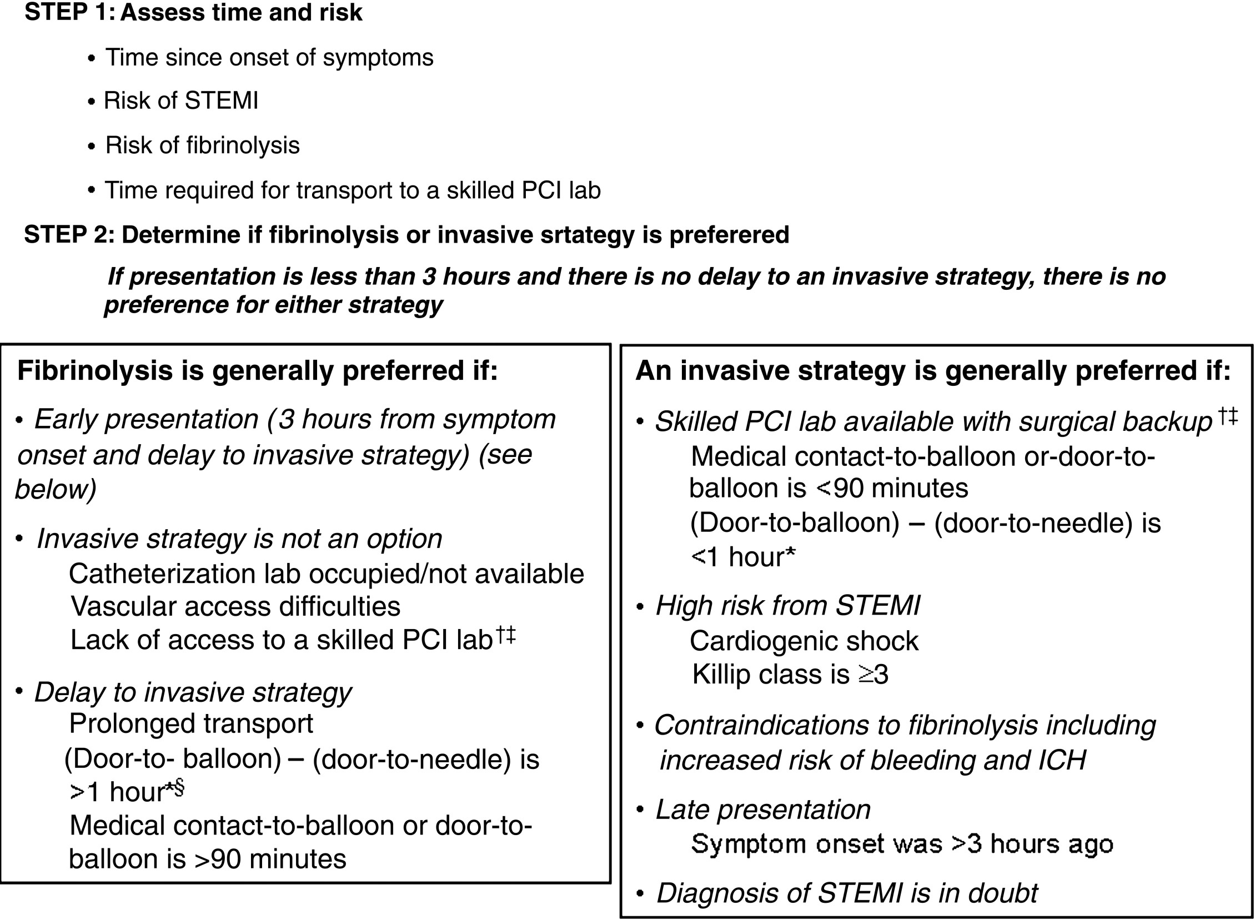

Slide 129
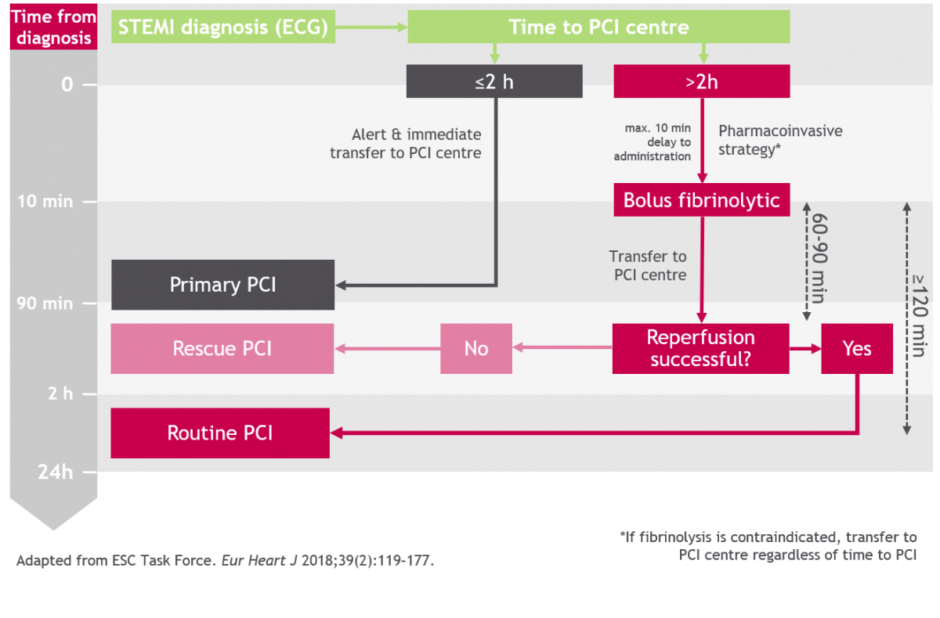

Slide 135
Antiplatelet therapy to support primary PCI for STEMI
I,A
Oral aspirin 300 mg should be given before primary PCI.⁹³⁻⁹⁵
In addition, a P2Y12 receptor inhibitor should also be given:
I,A
o Clopidogrel 300-600 mg loading dose to be given as early as possible⁷, or
II-a,B
o Prasugrel 60 mg loading dose to be given after the coronary angiogram has been performed or
II-a,B
o Ticagrelor 180 mg loading dose to be given as early as possible.^{26, 27}
II-a,A
Gp IIb/IIIa inhibitors may be considered in selected patients:
o Abciximab.
II-a,B
o Tirofiban.
Antithrombotic therapy to support primary PCI for STEMI
IV unfractionated heparin (UFH) with additional bolus to maintain activated clotting time (ACT) above 275.¹⁰⁵
IV low molecular weight heparin (LMWH) – enoxaparin.
IV fondaparinux is not recommended because of the risk of catheter thrombosis.⁵⁹
Bivalirudin infusion.
PCI access site
Both femoral and radial access is feasible depending on operator experience.
Radial access has the advantage of reducing bleeding complications. However when larger devices are necessary and the use of intra- aortic balloon pump (IABP) is anticipated, femoral access may be preferable.
I,A
.
I,B •
II-a,B
20

Slide 136
Contraindications and Cautions for Fibrinolytic Therapy in STEMI
Absolute contraindications
 Any prior ICH
 Known structural cerebral vascular lesion (eg, AVM)
 Known malignant intracranial neoplasm (primary or metastatic)
 Ischemic stroke within 3 months
EXCEPT acute ischemic stroke within 4.5 h
 Suspected aortic dissection
 Active bleeding or bleeding diathesis (excluding menses)
 Significant closed-head or facial trauma within 3 mo
 Intracranial or intraspinal surgery within 2 mo
 Severe uncontrolled hypertension (unresponsive to emergency therapy)
 For streptokinase, prior treatment within the previous1 yr

Slide 137
Contd…
◆ AV Block and Intraventricular Block
◆ Mitral Regurgitation
◆ Rupture of Interventricular septum
◆ Cardiac Temponade
◆ Post-Infarct Angina
◆ Pericarditis
◆ Mural Thrombus

Slide 138
Contd..
◆ Late Complications(>1 Week Post-MI)
◆ Post MI(Dressler’s) Syndrome
◆ LV Aneurysm
◆ Chronic Cardiac Failure

Slide 139
Limitation of infarct size (cont.)
FIBRINOLYSIS
Should be initiated within 30 min of presentation.
Tissue plasminogen activator (t-PA), streptokinase, tenecteplase (TNK), reteplase (rPA).
t-PA – 15mg bolus followed by 50mg IV over 30 min, 35mg next 60
min.
Streptokinase – 1.5 million units (MU) IV over 1 hr.
rPA – 10 MU bolus over 2-3 min, followed by 2nd 10 MU bolus after 30 min.
TNK – IV bolus 0.53mg/kg over 10 seconds.

Slide 140
Limitation of infarct size (cont.)
FIBRINOLYSIS
Should be initiated within 30 min of presentation.
Tissue plasminogen activator (t-PA), streptokinase, tenecteplase (TNK), reteplase (rPA).
t-PA – 15mg bolus followed by 50mg IV over 30 min, 35mg next 60
min.
Streptokinase – 1.5 million units (MU) IV over 1 hr.
rPA – 10 MU bolus over 2-3 min, followed by 2nd 10 MU bolus after 30 min.
TNK – IV bolus 0.53mg/kg over 10 seconds.

Slide 141
Choice of Fibrinolytic Agent
Fibrinolytic therapy may not be beneficial in patients who present more than 12 hours after symptom onset, although current practice guidelines recommend consideration of fibrinolysis in symptomatic patients with a large area of myocardium at risk (based on ECG or cardiovascular imaging) or hemodynamic instability if PCI is unavailable
Fibrinolytic therapy is associated with an excess of strokes, mainly due to cerebral hemorrhage, which is more commonly seen in patients with advanced age, lower weight, female sex, prior cerebrovascular disease, and hypertension on admission. ^{[85]}

Slide 142
Coronary artery bypass grafting (CABG)
Despite greatlimited role in the acute management of STEMI.
However, CABG remains indicated for cardiogenic shock, failed PCI, high-risk anatomy, surgical repair of a mechanical complication of STEMI (eg, ventricular septal rupture, free-wall rupture, or severe mitral regurgitation from papillary muscle dysfunction or rupture).
CABG is also the preferred revascularization strategy for patients with unprotected left main disease, but PCI with DES is a reasonable alternative treatment option in those with favorable anatomy and high surgical risk
improvement of intraoperative myocardial preservation, CABG has a

Slide 143
AntiCoagulant Therapy
Following treatment with both fibrin-specific and non fibrin- specific fibrinolytic agents, there is strong evidence for the use of antithrombotic agents for reducing reinfarction or recurrent ischemia.
Recent studies suggest that low molecular weight heparins (LMWH) may be better than unfractionated heparin (UFH) for this purpose.
The LMWHs enoxaparin or reviparin may be administered for up to 8 days post-MI.
Fondaparinux has recently been shown to reduce the occurrence of death or reinfarction while concomitantly reducing the risk of major bleeding, and may therefore be considered among patients undergoing treatment with streptokinase.
Use caution with the administration of enoxaparin in patients older than 75 years as well as those with impaired renal function, because the use of enoxaparin is associated with a higher risk of intracranial bleeding.
Bivalirudin may be used for patients who develop or have a history of heparin-induced thrombocytopenia (HIT) and require anticoagulation.

Slide 144
ANTICOAGULANTS
UNFRAC-TIONATED HEPARIN (UFH)
Long the mainstay of therapy
THE LOW-MOLECULAR- WEIGHT HEPARIN (LMWH), ENOXAPARIN
Which has been shown to be superior to UFH in reducing
recurrent cardiac events, especially in patients managed by a conservative strategy but with some increase in bleeding
BIVALIRUDIN, A DIRECT THROMBIN INHIBITOR
Causes less bleeding and is used just prior to and/or during PCI
INDIRECT FACTOR Xa INHIBITOR, FONDAPARINUX
Have a lower risk of major bleeding

Slide 145
Continue…..
◆
◆ Enoxaparin:
◆ ● If age 75 y: 30-mg IV bolus, followed in 15 min by 1 mg/kg subcutaneously every 12 h (maximum 100 mg for the first 2 doses)
◆ ● If age> 75 y: no bolus, 0.75 mg/kg subcutaneously every 12 h (maximum 75 mg for the first 2 doses)
◆ ● Regardless of age, if CrCl 30 mL/min: 1 mg/kg subcutaneously every 24 h
◆ ● Duration: For the index hospitalization, up to 8 d or until revascularization

Slide 146
LMWH - enoxaparin^{127,}
o In patients > 75 years of age and with renal impairment (serum creatinine (Scr) > 200 µmol/L in women and > 250 µmol/L in men), UFH is preferable to LMWH.
Anti Xa inhibitor – fondaparinux
o May be given to those patients treated medically including those not receiving fibrinolytic therapy. In STEMI patients not undergoing primary PCI and not receiving fibrinolytic therapy, fondaparinux was shown to reduce mortality and reinfarction without increasing bleeding and stroke rates when compared to UFH or placebo
It is associated with an increase in catheter-related thrombus and coronary angiographic complications. Thus, fondaparinux is not recommended as the sole anticoagulant during PCI.
Heparin | Dosage | Duration of therapy
Enoxaparin | < 75 years: 30 mg IV bolus, SC 1.0 mg/kg bd | Until hospital discharge
 | Š 75 years: no bolus, SC 0.75 mg/kg bd
UFH | 60 U/kg bolus (max 4000 U) | Š 48 hours
 | Infusion 12 U/kg/h (max 1000 U/h) – to maintain an activated partial thromboplastin time (APTT) of 1.5 – 2.5 x control
Fondaparinux | IV 2.5 mg bolus, followed by SC 2.5 mg once daily (od) | 8 days or until hospital discharge

Slide 147
Beta Adrenergic Antagonists
Oral beta-blockers should be administered in the first 24 hours to patients who do not have heart failure, a low output state, are not at increased risk of developing cardiogenic shock, or do not have other contraindications to beta-blocker therapy.
IV B BLOCKERS ARE GIVEN FOR PERSISTENT HYPERTENSION. They are contraindicated in Cardiogenic Schok .Metoprolol 5 mg iv may be given every 5 mins for 3 times. They decrease hr so increase diastole and coronary filling increases.. They decrease o2 consumtion of heart and decrease tachy arrhythmias , So INF WALL MI is usually associated with blocks it should be avoided.Avoid in pts with copd. Give selective B1 agonist like bisoprolol.
.
ACE inhibitors improve survival in patients who have reduced left ventricular ejection fraction (LVEF ≤40%) and those who are in heart failure following STEMI. Benefits are proportionately lower among low risk patients. ACE inhibitors should be started in the first 24 hours after STEMI in the absence of contraindications. AcE inhibitors and Arbs’ care should be taken to avoid hypotensi. Arbs may be used in patients who do not tolerate AcE inhibitors.
There is no role for the routine use of calcium antagonists, intravenous magnesium, antiarrhythmic agents or glucose- insulin-potassium infusions, and may be associated with adverse outcomes in some cases.
High dose statins should be initiated as early as possible during hospital stay as part of secondary prevention measures. The dose of statin to be used in Indian patients is not clear, but lowering LDL levels to ≤80mg/dL may be a useful target.Atorvastatin 80. Rosuvastatin 40mg.

Slide 148
Contraindications to ß-blockers:
Bradycardia < 60/minute.
SBP < 100 mmHg.
Pulmonary congestion with crepitations beyond the lung bases.
Signs of peripheral hypoperfusion.
Second or third degree atrio-ventricular (AV) block.
Asthma or chronic obstructive airway disease
Severe peripheral vascular disease.

Slide 149
Limitation of infarct size (cont.)
Coronary Artery Bypass Graft (CABG)
When PCI fails to prevent further
ischemia, CABG is considered.
Great saphenous vein from the leg is taken and grafted from aorta or its major branch to relevant obstructed coronary artery to immediately restore blood flow.

Slide 151
Hospital phase management
Monitoring cardiac rhythm and hemodynamic.
Limit movement of pt for 1st 3 days.
Diet – pt to receive nothing or clear liquid by mouth in 1st 4-12 hrs. Controlled diet are
given.
Bowel Management – diet rich in bulk, and stool softener are given to offset the effect of narcotics used in treatment.
Sedation, because pt need to sleep – Diazepam (5mg), Oxazepam (15-30mg), or Lorazepam (0.5-2mg) 3-4 times a day. Additional dose may be given at night for better sleep.

Slide 152
Complications of Acute Coronary Syndrome
Arrhythmias
Ischaemia
Acute circulatory failure
Pericarditis
Mechanical complications
Rupture of the papillary muscle
Rupture of the interventricular septum
Rupture of the ventricle
Embolism
Impaired ventricular function, remodelling and ventricular aneurysm

Slide 153
ARRHYTHMIAS
These include:
Tachyarrhythmias
Pulseless ventricular tachyarrythmias
This is either pulseless ventricular tachycardia (VT) or ventricular fibrillation (VF). Defibrillate immediately. Early VF occurs within the first 48 hours and is due to electrical instability. Late VF is associated with large infarcts and poor pump function and carries a poor prognosis.
Ventricular tachycardia (VT)
VT in the setting of STEMI may arise from either ischaemia (usually within 48 hours) or from myocardial scar due to the infarct (late onset). Treatment of ischaemia may result in the termination of the tachycardia).
Ventricular premature contractions (VPC)
These are often benign and do not require treatment. Correct underlying ischaemia, hypoxia and electrolyte disturbances.
28

Slide 154
Accelerated idioventricular rhythm
These do not require any treatment. This is a sign suggestive of successful reperfusion.
Atrial fibrillation (AF)
This is more commonly seen in the elderly and is associated with large infarcts. It denotes a poorer prognosis and carries an increased risk of thromboembolism
B) Bradyarrhythmias
Sinus bradycardia
This does not require treatment unless associated with symptoms and/or hypotension.
Atrio-ventricular (AV) block
First degree and second degree type 1 (Mobitz 1) do not need treatment. Patients with second degree type 2 (Mobitz 2) and complete AV block may not require treatment if haemodynamically stable. If unstable, urgent temporary pacing is necessary. Atropine may be given in the interim (maximum 3 mg)
Patients with anterior infarcts who develop second degree (Mobitz 2) and complete AV block carry a worse prognosis. Even if haemodynamically stable, these patients require temporary pacing.
In inferior MI, the inferior wall of the RV may be friable. Insertion of a temporary wire may lead to RV perforation. Thus extra care is equired to prevent this complication.
Asystole and pulseless electrical activity (PEA)
Rhythms which require defibrillation (pulseless VT/VF) are called shockable rhythms while asystole and PEA are non-shockable rhythms.
29

Slide 155
LV dysfunction and cardiogenic shock
LV dysfunction is the single strongest predictor of mortality following STEMI. The mechanisms responsible for acute LV dysfunction include
\ myocardial necrosis, myocardial stunning, atrial and ventricular arrhythmias and valvular dysfunction (pre-existing and/or new).
Presentation
The clinical manifestation of LV dysfunction varies from asymptomatic to cardiogenic shock. An important prognostic indicator is LVEFwhich can be assessed objectively using echocardiography.
A useful clinical classification of LV dysfunction is the Killip’s Classification.
Table 12: Clinical classification of LV dysfunction in STEMI (Killip’ Classification)
KILLIP CLASS¹⁶⁰ | CLINICAL FEATURES | APPROXIMATE PROPORTION OF PATIENTS WITH AMI (%)⁴² | 30 DAY- MORTALITY (%)⁴²
I | No signs of LV failure | 71 | 7
II | S3 gallop, bibasal crackles | 23 | 20
III | Acute pulmonary oedema | 3.7 | 39
IV | Cardiogenic shock | 2.4 | 70
Investigations
Echocardiography is an essential tool and needs to be performed early to assess LV function and volumes, valvular function, extent of myocardial damage and to detect mechanical complications.
Other investigations that may be helpful in the management include:
Chest radiograph (to assess extent of pulmonary congestion).
ECG (for the detection of arrhythmias, ischaemia or reinfarction).
Arterial blood gases.
Management
A) Acute Heart Failure
Acute management includes the following:
Oxygen – by nasal prongs/face mask to maintain SpO2 above 95%. Consider non-invasive ventilation [bi-level positive airway pressure (BiPAP) or continuous positive airway pressure (CPAP)] early if SpO2 cannot be maintained with high flow face mask.
30

Slide 156
Diuretics – IV frusemide.
IV nitrates.
Inotropes if hypotensive.
Noradrenaline should be the first choice agent. It is started at the lowest dose and titrated till the SBP is more than 80 mmHg.
Dopamine should be refrained as it has been associated with a higher mortality when used in patients with cardiogenic shock.
In patients who are hypoxic or exhausted and are unable to achieve satisfactory SpO2 despite non-invasive ventilation, endotracheal intubation and ventilatory support may be required.
B) Cardiogenic shock
This condition occurs in 6–10% of all cases of STEMI and remains a leading cause of death, with hospital mortality rates approaching 70%.
The typical presentation is of a low cardiac output state (hypotension with SBP < 90 mmHg, resting tachycardia, altered mental status, oliguria, cool peripheries) and pulmonary congestion. The haemodynamic criteria are an
elevated central filling pressure [pulmonary central wedge pressure (PCWP)] of > 18 mmHg and cardiac index is < 2.2 L/min/m2. Insertion of a pulmonary artery catheter may be helpful in the diagnosis and management of these patients.
Emergency PCI may be life-saving and should be considered early irrespective of the time delay from onset of MI. The use of IABP has not shown a definite benefit and its use should be individualised.
LV assist device may be considered for patients who do not respond to conventional therapies.
When cardiogenic shock is due to a mechanical defect, urgent surgical repair is indicated. Concomitant CABG surgery in these patients remains an issue of debate. The decision must be individualised.

Slide 157
Mechanical complications
These include the following:
Free wall rupture - it is usually fatal and presents with sudden cardiovascular collapse and haemopericardium.
Ventricular septal rupture.
Mitral regurgitation.
The diagnosis should be suspected in patients with sudden clinical deterioration and suggested by the presence of new murmurs or diminished heart sounds. The diagnosis can be confirmed by echocardiography In these patients early surgery should be considered.
31
Right Ventricular Infarct (RVI)
It occurs in 30 – 50% of patients with infero basal (formerly known as infero-posterior) MI and is associated with a significantly higher mortality. RVI can also occur in patients with extensive anterior STEMI.
Clinical diagnosis
The presence of RVI should be sought in all patients with inferior STEMI. The clinical triad of hypotension, clear lung fields and elevated jugular venous pressure in the setting of inferior STEMI is suggestive of RVI.
ST elevation in the right praecordial leads (V4R) is the most specific finding in diagnosing RVI. However, this ECG finding may be transient, often resolving within 8-10 hours.
Management
Treatment strategies depend on the severity of peripheral hypoperfusion and the degree of co-existing LV dysfunction. Drugs that reduce the preload,such as nitrates and diuretics should be avoided.
Management includes:
Optimisation of IV fluids (saline or colloids) is the key therapy to correct the hypotension.
Inotropes.
Others
2

Slide 158
Chest pain post-STEMI
Chest pain post-STEMI may be due to reinfarction, ischaemia or pericarditis. Non cardiac causes must also be considered.
Reinfarction
Reinfarction occurs in about 3-4% of patients who had undergone fibrinolytic therapy and received aspirin. Reinfarction may be diagnosed by:
Recurrence of ischaemic type chest pain.
Recurrence of ST segment elevation of at least 0.1 mv in at least two contiguous leads and/or
Re-elevation of serum cardiac biomarkers - CK-MB ( 20% increase in the value from the last sample).
Death, severe HF and arrhythmias are more common in these patients. They should be considered for rescue PCI.
Post-infarct angina
Early recurrent angina, especially after successful reperfusion with fibrinolytic therapy may occur in up to 18% of patients. The ECG in these patients may show ST segment changes or pseudo- normalisation of inverted T-waves. These patients should be sent for early coronary angiography with a view to revascularisation.
Pericarditis
Pericarditis secondary to STEMI may produce pain as early as the first day and as late as 6 weeks. The pain classically becomes worse on deep inspiration and may be relieved when the patient sits up and leans forward. A pericardial rub may be detected.

Slide 159
Dressler’s syndrome (post-MI syndrome) usually occurs 2-10 weeks after STEMI. This is immunologically mediated. It is treated with aspirin 600 mg 3-4 times a day.
Acetaminophen or narcotic analgesics may be reasonable if aspirin, even in higher doses, is not effective.
Glucocorticoids and non-steroidal anti-inflammatory drugs (NSAIDs) are potentially harmful for treatment of pericarditis after STEMI and are best avoided in the first 4 weeks of STEMI.^{170, 171}
LV thrombus and arterial embolism
The prevalence of LV mural thrombus has been reduced from 20% to 4% in the era of primary PCI. The majority of these occur following anterior or large infarcts. Anticoagulation therapy is recommended for 3-6 months or till the LV thrombus disappears or organises on echocardiography.
Deep venous thrombosis (DVT)
In high-risk patients (prolonged bed rest, HF, unable to mobilise), prophylactic anti-coagulation therapy (SC heparin 5000 units bd, LMWH
– e.g. enoxaparin 40 mg od) may be considered until the patient is ambulant.
33

Slide 160
SECONDARY PREVENTION
Patients who survive the initial course of STEMI are at increased risk of morbidity and mortality because of reinfarction and the development of other complications such as HF and late onset arrhythmias. Thus, it isimportant that efforts be made to reduce this risk.
Secondary prevention should be initiated in-hospital. Patients should be advised on the benefits and importance of lifestyle changes. A close collaboration between the cardiologist, the general/family physician, the rehabilitation specialist, pharmacists and dietician is important.
These lifestyles measures include:
Cessation of smoking
In patients with known CHD, smoking cessation reduced CHD mortality by 36% as compared to those who continued smoking.¹⁸⁹ Following MI, smoking cessation reduced subsequent mortality by nearly 50%.
This lifestyle change confers a risk reduction which is at least as great as other pharmacological interventions. Stopping smoking is potentially the most effective of all secondary prevention measures.¹
Trials of nicotine replacement therapy using either transdermal nicotine patch or nicotine chewing gum have proven to greatly increase abstention rates after cessation. Nicotine patches have been demonstrated to be safe in ACS patients.¹⁹¹ Such pharmacological therapy, as well as physician-guided counselling and nurse-directed programmes are cost-effective and should be encouraged.
The safety of electronic cigarettes is uncertain at this time.
Diet and weight control
I,B Dietary intervention has been shown to reduce cardiac event rates post-STEMI.¹⁹⁴⁻¹⁹⁶
Recommendations include:
Total calorie intake should be tailored to the desirable body weight.
Substituting saturated and trans fat with monounsaturated and polyunsaturated fat from vegetables and marine sources.
Reducing total fat to 30% of total calorie intake.
More high fibre food and whole grains which have low glycaemic index instead of more rapidly digested carbohydrates.
More fruits, nuts and vegetables.
Increasing intake of omega 3-fatty acids by eating fish at least twice a week.
Reducing salt intake – no added table salt.
Increasing intake of oat ß-glucan to at least 3 g a day will lower total and LDL-C by 5-10%.
37

Slide 161
7.3 Regular exercise
Exercise training as part of coronary rehabilitation programmes was associated with a reduction in cardiac mortality in patients with
CHD. Exercise-based rehabilitation has been shown to be effective at reducing all-cause mortality and the risk of reinfarction, as well as improving risk factors, exercise capacity and health-related quality of life after STEMI.²Thirty minutes of moderate intensity aerobic exercise at least five times per week is recommended. It should be supplemented with an increase in daily lifestyle activities such as walking up stairs whenever possible.²⁰¹
7.4 Control of hypertension
After STEMI, prognosis is affected by both the pre-existing and the subsequent BP. The higher the pre-existing BP, the higher the fatality rate. After ACS, the BP goal should be systolic < 140 mmHg but not < 110 mmHg. Drugs of choice include ß-blockers, ACE-Is and ARB (if ACE-I intolerant). In addition, lifestyle modification (reduced salt intake, increased physical activity and weight loss) usually helps achieve these goals.
7.5 Good glycaemic control
II-,B Good control of the blood glucose is important and should be individualised.
7.6 Antiplatelet agents
I,A
Aspirin – low dose aspirin 75-100 mg daily is indicated indefinitely after STEMI unless contraindicated. ¹
In patients who cannot tolerate aspirin, alternatives include: o Clopidogrel, 75 mg daily.
o Ticlopidine, 250 mg b.d.
I,C
I,A
DAPTs should be given for at least one month post-fibrinolytic therapy for secondary prevention.
Following primary PCI, DAPT with combination of aspirin and clopidogrel or ticagrelor or prasugrel is recommended.
DAPT with aspirin and oral adenosine diphosphate (ADP) receptor antagonist is recommended to be continued for up to 12months after
STEMI¹²⁴, with a strict minimum:
1 month for patients receiving BMS.
6 months for patients receiving DES.
38

Slide 162
7.7 ß-blockers
Oral treatment with ß-blockers is indicated in patients with HF or LV dysfunction When patients are haemodynamically stable, ß-blockers may be initiated.
7.8 ACE-Is and ARBs
ACE-Is are indicated starting within the first 24 hours of STEMI in high-
risk patients (LVEF < 40% or who have experienced HF in the early phase, DM or an anterior infarct) and should be continued indefinitely if there are no contraindications.¹
In ACE-I intolerant patients, an ARB may be used preferably valsartan.
7.9 Mineralocorticoid antagonists
Mineralocorticoid antagonists, e.g. eplerenone should be considered in patients with LVEF < 40% and HF in the absence of renal failure or renal impairment.
I,B
7.10 Lipid-lowering therapy
A lipid profile should be taken as soon as possible after presentation.
I,C
Statins at high dose should be initiated early after admission in patients with STEMI who do not have contraindication or history of intolerance, regardless of initial cholesterol values and continued indefinitely.
I,A
I,B • Target LDL-C should be < 2.0 mmol/L.
I,B
Recent studies indicate that lowering LDL-C even further (< 1.8 mmol/L) confers greater benefits.
7.11 Oral anticoagulants (warfarin)
,C
In patients with a clear indication for oral anticoagulation e.g. LV
thrombus, AF with CHA₂DS₂-VASC score ≥ 2 or mechanical prosthetic
valve, oral anticoagulation must be implemented in addition to antiplatelet therapy (Appendix V, page 58).
The optimal duration of triple therapy is unknown and clinical judgement should consider the risk of bleeding versus the risk of stent thrombosis.
There is insufficient data on the use of new oral anticoagulant agents at this time.
In patients with LV thrombus, warfarin should be given for 3-6 months or till the thrombus disappears or organises.^{172, 235}
39
II-a,B

Slide 163
7.12 Others
III,A
Hormone replacement therapy (HRT) is not beneficial for secondary prevention.^{236, 237}
III,A
Vitamin E and antioxidants have no clinical benefit.²³⁸⁻²⁴⁰
III,C
Garlic, lecithin, Vitamin A and C are not beneficial.
Key Messages:
Secondary prevention interventions such as smoking cessation, statin therapy, control of diabetes, hypertension and lifestyle changes can reduce mortality and cardiac event rate post-STEMI.
Healthcare providers must provide patient education and encourage compliance.
SPECIAL GROUPS
STEMI in the elderly
Patients above the age of 75 years have a much higher in-hospital as well as 1-year mortality.²⁴¹⁻²⁴³ This may be explained by their atypical and delayed presentations, co-morbidities and under-utilisation of reperfusion strategies.^{244, 245} Diagnosis may be delayed because of:
Atypical symptoms such as dyspnoea, syncope and acute confusion.
Non-diagnostic and difficult to interpret ECGs.
Non-diagnostic cardiac biomarkers. The baseline troponin levels may be elevated in as many as 22% of the elderly without an MI because of pre-existing cardiac and renal disease.^{246, 247} Thus, a high index of suspicion must be present to make a diagnosis of ACS in the elderly. The trend of a rise and fall cardiac biomarker levels is critical to the diagnosis.
Management
The elderly are a heterogenous group and the risk-benefit ratio of each intervention should be
Individualised.
CKD is common in these patients and may increase the risk of bleeding. Most drugs are excreted by the kidneys and doses need to be adjusted. Creatinine clearance (CrCL) should be estimated using the Cockcroft- Gault (Appendix VI, page 59), Modification of Diet in Renal Disease (MDRD) equations (Appendix VII, page 59) or CKD-EPI (Chronic Kidney
Disease Epidemiology Collaboration) equations (Appendix VIII, page 59).
40

Slide 164
For the general practitioner / family physician
Ask patient to chew and swallow one 300 mg tablet of (non-enteric coated) aspirin.
Give sublingual GTN if systolic blood pressure (SBP) is more than 90 mmHg.
If the ECG shows ischaemic changes, give 300 mg of clopidogrel if available.
I,
Wherever possible, set up intravenous (IV) access.
Give oxygen by mask/nasal prongs if the patient is dyspnoeic and/ or SpO2 is < 95%.
Pain relief with titrated IV opiates [IV morphine 3-5 mg slowly]. IV antiemetic may be administered to prevent opioid induced vomiting.
Avoid intramuscular injections since this could result in intramuscular haematomas if fibrinolytic agents are subsequently administered.
Call an ambulance or ask the patient’s relative or friend to send the patient immediately to the nearest hospital.
Wherever possible, contact the doctor at the hospital so that the patient can be treated promptly on arrival.
9

Slide 165
4 IN-HOSPITAL MANAGEMENT
Early management of STEMI is directed at:
Pain relief.
Establishing early reperfusion.
Treatment of complications.
Initial recognition and management
I,A When the patient with suspected STEMI reaches the emergency department, evaluation and initial management should be prompt (FAST TRACK - RED ZONE) because the benefits of reperfusion therapy are greater the earlier it is instituted.
I,C A quick targeted history should be taken and vital signs noted. The diagnosis should be confirmed with an ECG, which should be done as soon as possible, preferably within 10 minutes of the patient’s arrival in the emergency department. It is important to monitor the patient continuously for arrhythmias.
Pain should be relieved with titrated IV morphine.
The patient’s suitability for reperfusion by either fibrinolytic therapy or primary PCI should be quickly assessed.
The following should be done immediately and concomitantly in the emergency department
Assessment and stabilisation of the patient’s haemodynamics.
Sublingual GTN if chest pain persists (avoid if SBP < 90 mmHg).
Continuous ECG monitoring.
300 mg of non-enteric coated aspirin chewed and swallowed if not given earlier.
I,C
I,C
I,C
I,A
I,A
II-a,B
Clopidogrel at a dose of 300 mg should be given, if not given earlier.^{19, 20}
I,C
Alternatively, ticagrelor at a loading dose of 180 mg may be given if primary PCI is being considered. Ticagrelor has not been tested with fibrinolytic therapy.
I,C
Oxygen by nasal prongs/facemask if SpO2 is less than \90
Venous access established and blood taken for cardiac biomarkers, full blood count, renal profile, glucose and lipid profile. Preferably two IV lines should be set up.
11

Slide 166
Pain relief - morphine should be administered IV at 2-5 mg by slow bolus injection every 5-15 minutes as necessary. Watch for adverse events – hypotension and respiratory depression. Anti-emetics (IV metoclopromide 10 mg or promethazine 25 mg) should be given with morphine and 8-hourly as necessary.
I,C
Intramuscular injections should be avoided.
I,C
Assessment for reperfusion strategy.
I,C
A patient’s immediate and long term prognosis following STEMI can be predicted by using the Thrombolysis in Myocardial Infarction (TIMI) risk score .The TIMI risk score was specifically developed for patients with STEMI. Risk assessment is a continuous process that should be repeated throughout hospitalisation and at the time of discharge.
4.2 Reperfusion strategies
The appropriate and timely use of some form of reperfusion therapy is more important than the choice of therapy.
_{I,A} Early and prompt reperfusion is crucial as TIME LOST is equivalent to MYOCARDIUM LOST.
I,A Overwhelming data has shown that prompt reperfusion therapy improves survival.
I,A Primary PCI is superior to fibrinolytic therapy as a reperfusion strategy.,
35
I,A
12

Slide 167
TIMI Risk Model for Prediction of Short-Term Mortality in ST-Segment Elevation Myocardial Infarction Patients

Slide 168
The best reperfusion strategy will depend upon:
A) Time from onset of symptoms to FMC
Early presentation (within 3 hours of symptom onset)
I,A If both treatment options are readily available, they have been shown to be equally effective
Late presentation (3 to 12 hours of symptom onset)
Primary PCI is preferred. The DBT should be within 90 minutes if the patient presents at a PCI capable facility.
If transferred from a centre with no PCI facilities, DBT should be less than 2 hours (including transfer delay).
If the time delay to primary PCI is longer than as mentioned, then the next best option is to give fibrinolytic therapy and make arrangements to transfer the patient to a PCI capable centre for pharmacoinvasive treatment.⁴
Very late presentation (> 12 hours)
Bothprimary PCIandfibrinolytictherapyare not routinelyrecommended in patients who are asymptomatic and haemodynamically stable.
However, reperfusion therapy would still be beneficial in patients with persistent ischaemic symptoms, haemodynamic or electrical instability. In this subgroup, primary PCI is the preferred strategy.
I,A
I,C

Slide 169
Thank You
www.freemeditation.com
www.drsandeeprai.com

Slide 171
19
Approach to STEMI and NSTEMI
UA/ NSTEMI
Clinical presentation
Acute chest pain is one of the most common reasons for
Patients with Acute Chest Pain
15-20% Patients with ACS
ECG
No ST elevation
ST elevation
Cardiac biomarkers (Troponin, CPK-MB Normal)
Cardiac biomarkers (Troponin, CPK-MB Raised)
Unstable angina (UA)
Non ST elevation myocardial infarction (NSTEMI)
ST elevation myocardial infarction (STEMI)

Slide 172
19
Approach to STEMI and NSTEMI
Acute coronary syndrome (AcS) refers to any constellation of clinical symptoms that are compatible with acute myocardial ischemia.
AcS is divided into ST- elevated myocardial infarction (STEMI), non-ST elevated myocardial infarction (NSTEMI), and unstable angina (UA).
STEMI results from complete and prolonged occlusion of an epicardial coronary blood vessel and is defined based on EcG criteria. .
NSTEMI usually results from severe coronary artery narrowing, transient occlusion, or microembolization of thrombus and/or atheromatous material.
NSTEMI is defined by an elevation of cardiac biomarkers in the absence of ST elevation.
The syndrome is termed UA in the absence of elevated cardiac enzymes.
History, physical examination, ECG, biochemical markers, ECHO all remain important tools to make an appropriate diagnosis
The management of ACS should focus on rapid diagnosis, risk stratification, and institution of therapies that restore coronary blood flow and reduce myocardial ischemia.

Slide 173
Prolonged (> 20 min) anginal pain at rest.
New onset (de novo) severe angina (class III of the classification of Canadian Cardiovascular Society (CCS).⁷
Recent destabilization of previously stable angina with at least CCS III angina characteristics (crescendo angina) or
Post MI angina.
The typical clinical presentation of NSTE AcS is retro sternal

Slide 174
Table 2 : The indications for urgent coronary angiography
Refractory angina (e.g. evolving MI).
Recurrent angina despite intense antianginal treatment (associated with ST depression (≤ 2 mm) or deep negative T waves.
clinical symptoms of heart failure or haemodynamic instability (‘Shock’).
Life threatening arrhythmias (ventricular fibrillation or
ventricular tachycardia).

Slide 175
Electrocardiogram (ECG)
In NSTE ACS, ECG may show ST segment deviation, T wave changes or may remain normal.
The number of leads showing ST depression and the magnitude of ST depression are indicative of the extent and severity of ischemia and correlate with the prognosis.
⁹ ST depression of > 2 mm carries an increased mortality risk. Inverted T waves, especially if marked (greater than or equal to 2mm (0.2 mv) also indicate UA/ NSTEMI.

Slide 176
20
Table 1 : The TIMI risk score for NSTE-ACS
Characteristics Points
Historical
Age ≥ 65
≥ 3 risk factors for CAD
(Dm,htn, SMOKING,HIGH Cholesterol, Family History)
Known CAD (Stenosis ≥ 50 %)
Aspirin use in past 7 days
1
1
Presentation
2 anginal events in < 24 hrs
ST – segment deviation ≥ 0.5 mm
↑ cardiac markers risk Score = Total Points
1
1
1
1
1
(0-7)
PATIENT WITH NSTEMI
ASPIRIN 162-325MG ENTERIC COATED F/B 75-150MG DAILY. CLOPIDOGREL 300 MG F/B 75 MG DAILY.(PCI-600 MG LD) LMWH ENOXAPARIN 1MG/KG BD SC
BETA BLOCKER/CCB SL/IV NTG
STATIN 80 MG
LOW RISK(TIMI <3)
INTERMEDIATE RISK (TIMI3-4)
HIGH RISK (TIMI5-7)
EARLY NONINVASIVE STRESS TESTING
OBSERVE FOR 8-12 HRS FOR RECURRENT CHEST PAIN , ARRHYTHMIAS.
ECG/CARDIAC ENZYMES DONE
NONINVASIVE STRESS TESTS AND CT ANGIO
NEGATIVE
POSITIVE
1DISCHARGE PATIENT ON MEDICAL MANAGEMENT 2.F/U AFTER 3 DAYS/SOS
NORMAL
ABNORMAL
ADMIT THE PATIENT
IMMEDIATE/EARLY CAG
+/- PCI WITH GPIIB/IIIA OR
Fig. 2 : Approach to Management of STEMI

Slide 177
Cont.
Risk assessment by Thrombolysis In Myocardial Infarction Trial (TIMI) , which include seven independent risk factor.
The present of abnormally elevated cTn very important
Extent of myocardial damage
Other risk include
Diabetes mellitus
Renal dysfunction
Elevated level of Brain Natriutic Peptide and C-Reactive protein
Patient with ACS without elevation of cTn are considered to develop unstable angina and have more favourable prognosis than those with cTn elevation (STEMI)
Early risk assesmen tuseful in
=predict the risk of recurremt cardiac event
= identify a patient who will derives an benfit from early invasive strategy

Slide 179
NSTE ACS includes a heterogeneous group of patients with a highly variable prognosis.
The risk stratification (Table 1) is necessary for prognosis assessment and treatment.
A simple TIMI risk score¹¹ has been validated and can be used.A TIMI score <3 usually indicates a low risk and a TIMI score = 3-4 indicates intermediate risk, where as score of 5-7 is high risk.
In general, patients having multiple coronary risk factors, advanced age, rest angina, clinical left ventricular (LV) dysfunction, prior history of percutaneous coronary intervention (PCI) or coronary artery bypass graft surgery (CABGS) or patients with dynamic ST-T changes and elevation of troponin or CK-MB indicates myocyte necrosis and a high risk.

Slide 180
Anticoagulants
Anticoagulation is recommended for all patients in addition to antiplatelet agents.^{3,4} An increasing number of agents are available and include unfractionated heparin (UFH), low molecular weight heparin (LMWH), fondaparinux and bivalirudin. The choice of anticoagulation depends on the risk of ischemic and bleeding events and choice of the initial management strategy (e.g. urgent invasive, early invasive or conservative).
Enoxaparin (1mg/kg bw twice daily) is a preferred anticoagulant and is a good option in patients treated conservatively or by invasive strategy. Enoxaparin can be stopped within 24 h after an invasive strategy whereas it should be administered up to hospital discharge (usually 3 to 5 days) in conservative strate

Slide 181
INVASIVE VERSUS CONSERVATIVE STRATEGY
Benefit of an early invasive strategy in high-risk patients
Patients with multiple clinical risk factors,
ST-segment deviation,
And/or positive biomarkers
In this strategy, following treatment with
Anti-ischemic and antithrombotic agents, coronary arteriography is carried
out within ~48 h of presentation
Followed by coronary revascularization (PCI or coronary artery bypass grafting)
In low-risk patients, the outcomes from an invasive strategy are
similar to those obtained from a conservative strategy.

Slide 182
LONG-TERM MANAGEMENT
The time of hospital discharge
“teachable moment” for the patient with NSTE-ACS,
Review and optimize the medical regimen.
Risk-factor modification is key, and the caregiver should
discuss with the patient the importance of smoking cessation
achieving optimal weight
daily exercise
blood-pressure control
following an appropriate diet,
control of hyperglycemia (in diabetic patients)
lipid management as recommended for patients with chronic stable angina

Slide 183
Cont.
There is evidence benefits with long term therapy of 5 clases of drug that act at different component of the atherothrombotic process
Beta blockler
Statin
ACEI
ARB
Anti-platelet now recommended to be the combination of low-dose (75–100 mg/d) aspirin and a P2Y12 inhibitor (clopidogrel, prasugrel, or ticagrelor) for 1 year, with aspirin continued thereafter, prevents or reduces the sever-ity of any thrombosis that would occur if a plaque were to rupture

Slide 184
Coronary revascularization
Revascularization for NSTE ACS is performed to relieve angina, ongoing myocardial ischemia and to prevent progression to MI or death. The indications for revascularization and the preferred approach, PcI or cAbGS depend on the extent and severity of the lesions, the patient’s condition and co-morbidity (Tables 1 and 2).²⁰
The indications for urgent coronary angiography and invasive strategy are shown in Table 2.
Conservative and Invasive Strategy
RCT’s have shown that an early invasive strategy reduces ischemic end points mainly by reducing severe recurrent ischemia and the need for re-hospitalization and revascularization.²¹ This strategy reduces cardiovascular death and MI up to 5 years of follow-up.²² High risk/unstable patients benefit most from the early revascularization therapy and these patients should be promptly treated in advanced centers.
The mode of revascularization is usually based on the severity and distribution of the cAd. The PcI is usually performed for the culprit lesion using drug eluting stents. Significant lesions in multiple vessels can be treated either in the same sitting or in a staged fashion as considered appropriate. CABG is usually advised for complex cAd not amenable to PcI, left main with triple vessel disease, total occlusions and diffuse disease. It is important to consider the bleeding risk as these patients are on aggressive antiplatelet therapy. The benefits of CABG are greatest after several days of stabilization with medical treatment and stopping the antiplatelet agents.

Slide 185
Fondaparinux is recommended on the basis of most favourable efficacy/ safety profile and the recommended dose is 2.5 mg daily.¹⁸ This agent causes least bleeding complications. An additional UFH in standard dose of 50-100 U/kg bolus is necessary during PCI due to slightly high incidence of catheter thrombosis.
bivalirudin is currently recommended as an alternative anticoagulant for urgent and elective PCI in moderate or high risk NSTE AcS.¹⁹ Bivalirudin reduces the risk of bleeding as compared with UFH/LMWH plus GP IIb/IIIa inhibitor but needs bolus of heparin additionally during. PCI to prevent stent thrombosis.
Statins and other drugs
Statins are recommended for all NSTE AcS patients, irrespective of cholesterol levels, initiated early after admission, with the aim of achieving LDL C levels <70 mg/dL. Atorvastatin is usually the preferred agent, at a dose of 80mg per day. ACE inhibitors are indicated in patients with reduced LV systolic function. Arb’s are indicated in those patients who are intolerant to AcE inhibition.

Slide 186
Management : \
. Patients who are awaiting hospitalization are advised to chew non-enteric coated aspirin (162 to 325 mg) and use sublingual nitrate for pain relief. and careful observation for recurrent ischemia.
High risk patients, including those with continuing discomfort and/ or haemodynamic instability, should be hospitalized in a coronary care unit (CCU) and observed for at least 24-48 hours.
Fibrinolytic (thrombolytic) therapy using streptokinase, urokinase, tenecteplase or any other agent should not be used in patients with UA and NSTEMI. These agents can prove harmful.
Anti- ischemic and analgesic therapy
Oxygen is useful for initial stabilization particularly in those with hypoxemia.
Topical, oral or intravenous nitrates are recommended for pain relief. Intravenous nitroglycerin (NTG) is particularly helpful in those who are unresponsive to sublingual NTG, in hypertension and in those with

Slide 187
Decision 2: Classify the patient according to presentation of ST-segment.
ECG shows ST depression or dynamic T-wave inversion
Start adjunctive treatments for NSTEMI, as indicated:
Nitroglycerin
Beta-adrenergic receptor blocker
Clopidogrel
Heparin (UFH or LMWH)
Glycoprotein IIb/IIIa inhibitor
If more than 12 hours has passed since the patient's onset of symptoms, do the following:
Admit patient to the hospital
Assess risk status
Continue ASA, heparin, and other therapies as indicated (ACE inhibitors, statins) for the high-risk patient characterized by:
Refractory ischemic chest pain
Recurrent or persistent ST deviation
Ventricular tachycardia
Hemodynamic instability
Signs of pump failure
Decision 2: Classify the patient according to presentation of ST-segment.
ECG shows normal ECG or nonspecific ST-T wave changes
Consider admitting the patient to hospital or to a monitored bed in ED

Slide 188
After the acute phase of STEMI, therapeutic lifestyle changes (including smoking cessation, exercise and dietary modification) and drugs for secondary prevention assume critical roles in improving outcomes in the medium and long-term.
Patient counseling and education are key to maintaining adherence to therapy in the long run.
For patients being discharged home, emphasize the following:
Timely follow-up with primary care provider
.
compliance with discharge medications, specifically aspirin and other medications

Slide 190
Angina

Slide 191
Introduction
A type of chest pain
Not a disease, its a symptom of an underlying heart problem specially IHD
Described as ‘heavy’, ‘tight’ or ‘gripping’.
Typically, central/retrosternal
Mild ache to most severe that provokes sweating and fear
Associated breathlessness.

Slide 192
Canadian cardiovascular society functional classification of angina
CLASS | Characteristic
Class I | No angina with ordinary activity. Angina with strenuous activity
Class II | Angina during ordinary activity, e.g. walking up hills, walking rapidly upstairs, with mild limitation of activities
Class III | Angina with low levels of activity, e.g. walking 50– 100 yards on the flat, walking up one flight of stairs, with marked restriction of activities
Class IV | Angina at rest or with any level of exercise

Slide 193
Classical or Exertional Angina Pectoris
Characterized by
constricting discomfort in the front of the chest, arms, neck, jaw;
provoked by physical exertion, especially after meals and in cold, windy weather or by anger or excitement and
relieved (usually within minutes) with rest or glyceryl trinitrate. Occasionally, it disappears with continued exertion (‘walking through the pain’).
Typical angina: all three features,
Atypical angina: two out of the three,
Non-anginal chest pain: one or less of these features

Slide 194
Types of Angina
Stable Angina: episodic clinical syndrome where there is no change in severity of attacks.
Unstable angina: Deterioration(24 hrs) in previous stable angina with symptoms frequently occurring at rest, i.e. acute coronary syndrome
Refractory angina: patients with severe coronary disease in whom revascularization is not possible and angina is not controlled by medical therapy.
Variant (Prinzmetal’s) angina: occurs without provocation, usually at rest, as a result of coronary artery spasm, more frequently in women

Slide 195
Stable Angina
Characterised by central chest pain, discomfort or breathlessness that is precipitated by exertion or other forms of stress and is promptly relieved by rest
Activities precipitating angina
Common
Physical exertion
Cold exposure
Heavy meals
Intense emotion
Uncommon
Lying flat (decubitus angina)
Vivid dreams (nocturnal angina)

Slide 196
Clinical Features
History is by far the most important factor in making the diagnosis
Physical examination is frequently unremarkable
But careful search for evidence of
valve disease (particularly aortic),
left ventricular dysfunction (cardiomegaly, gallop rhythm)
arterial disease (carotid bruits, peripheral vascular disease)
unrelated conditions that may exacerbate angina (anaemia, thyrotoxicosis).
Important assessment of risk factors e.g. hypertension, diabetes mellitus

Slide 197
Investigation
Resting ECG
may show evidence of previous MI but is often normal, even in
patients with severe CAD.
Occasionally, there is T-wave flattening or inversion in some leads, providing non-specific evidence of myocardial ischaemia or damage.
The most convincing evidence of myocardial ischaemia - reversible ST segment depression or elevation, with or without T-wave inversion, at the time the patient is experiencing symptoms
Exercise ECG
Exercise tolerance test (ETT) - standard treadmill or bicycle while
monitoring the patient’s ECG, BP and general condition.
Planar or down-sloping ST segment depression of ≥ 1mm is indicative of ischaemia (A, B)
Up-sloping ST depression is less specific and often occurs in
normal individuals (C)

Slide 198
Investigation

Slide 199
Investigation
Other forms of stress testing
Myocardial perfusion scanning
Stress echocardiography
Coronary arteriography
detailed anatomical information about the extent and nature of coronary artery disease
indicated when non-invasive tests have failed to establish the cause of atypical chest pain
under local anaesthesia
requires specialised radiological equipment, cardiac monitoring and an experienced operating team

Slide 200
Management
Management of angina pectoris involves
careful assessment of the likely extent and severity of arterial disease
identification and control of risk factors such as smoking, hypertension and hyperlipidaemia
use of measures to control symptoms
Identification of high-risk patients
for treatment to improve life expectancy.

Slide 201
Management: Medical
Antiplatelet therapy
Low-dose (75 mg) aspirin
reduces the risk of adverse events such as MI
prescribed for all patients with CAD indefinitely
Clopidogrel (75 mg daily)
equally effective ALTERNATIVE
if aspirin causes dyspepsia or other side-effects
Anti-anginal drug treatment: Five groups of drug
Nitrates
β-blockers
calcium antagonists
potassium channel activators
I_{f} channel antagonist

Slide 202
Management: Medical
Nitrates
act directly on vascular smooth muscle to produce venous
and arteriolar dilatation
reduction in myocardial oxygen demand
Increase in myocardial oxygen supply
prophylactically before taking exercise that is liable to provoke symptoms.
Continuous nitrate therapy can cause pharmacological tolerance
avoided by a 6–8-hour nitrate-free period
Nocturnal angina: longacting nitrates can be given at the end of the day

Slide 203
Management: Medical
β-blockers: lower myocardial oxygen demand by reducing heart rate, BP and myocardial contractility
provoke bronchospasm in patients
with asthma.
Calcium antagonists
inhibit the slow inward current
caused by the entry of extracellular calcium through the cell membrane of excitable cells,
particularly cardiac and arteriolar smooth muscle
lower myocardial oxygen demand by
reducing BP and myocardial contractility

Slide 204
Management: Medical
Potassium channel activators
arterial and venous dilating properties
but do not exhibit the tolerance seen with nitrates.
Nicorandil (10–30mg 12-hourly orally) - only drug in this class currently available for clinical use
I_{f} channel antagonist
Ivabradine is the first of this class of drug
Induces bradycardia by modulating ion channels in the
sinus node
Comparatively, does not have other cardiovascular effects
Safe to use in patients with heart failure

Slide 205
Management: Medical
It is conventional to start therapy with
low-dose aspirin,
a statin,
sublingual GTN
β-blocker,
And then add a calcium channel antagonist or a long-acting nitrate later if needed
goal is the control of angina with minimum side-effects and the simplest possible drug regimen
little evidence that prescribing multiple anti-anginal drugs is of benefit,
Revascularisation - if an appropriate combination of two or more drugs fails to achieve an acceptable symptomatic response

Slide 206
Percutaneous Coronary Intervention (PCI)
Passing a fine guide-wire across a coronary stenosis under radiographic control
Ballon is placed and then inflated to dilate the stenosis
Then a coronary stent is deployed on a balloon
maximise and maintain dilatation of a stenosed vessel
reduces both acute complications and the incidence of clinically important restenosis
Mainly used in single or two-vessel disease

Slide 207
Coronary artery bypass grafting (CABG)
Stenosed artery is by-passed with
internal mammary arteries
radial arteries
reversed segments of the patient’s own saphenous vein
Major surgery under cardiopulmonary bypass,
But in some cases, grafts can be applied to the beating heart: ‘off-pump’ surgery
Operative mortality is approximately 1.5% but risks are higher
elderly patients,
with poor left ventricular function
those with significant comorbidity, such as renal failure
90% of patients are free of angina 1 year after CABG surgery, but fewer than 60% of patients are asymptomatic after 5 or more years.

Slide 208
Types of MI
There are three types of MIs:
Type 1 – spontaneous MI with ischaemia due to a primary coronary event, e.g. plaque erosion/rupture, fissuring or dissection
Type 2 – MI secondary to ischaemia due to increased oxygen demand or decreased supply, such as coronary spasm, coronary embolism, anaemia, arrhythmias, hypertension, or hypotension
Type 3,4,5 – diagnosis of MI in sudden cardiac death, after percutaneous coronary intervention (PCI) and after coronary artery bypass graft (CABG), respectively.

Slide 209
Coronary artery bypass grafting (CABG)

Slide 210
Nonmodifiable risk factors for atherosclerosis include the following:
Age
Sex
Family history of premature coronary heart disease
Male-pattern baldness
Modifiable risk factors for atherosclerosis include the following
Smoking or other tobacco use
Hypercholesterolemia and hypertriglyceridemia, including inherited lipoprotein disorders
Dyslipidemia
Diabetes mellitus
Hypertension
Obesity (abdominal obesity)
Psychosocial stress
Sedentary lifestyle and/or lack of exercise
Reduced consumption of fruits and vegetables
Poor oral hygiene
Type A personality
Elevated homocysteine levels
Presence of peripheral vascular disease

Slide 211
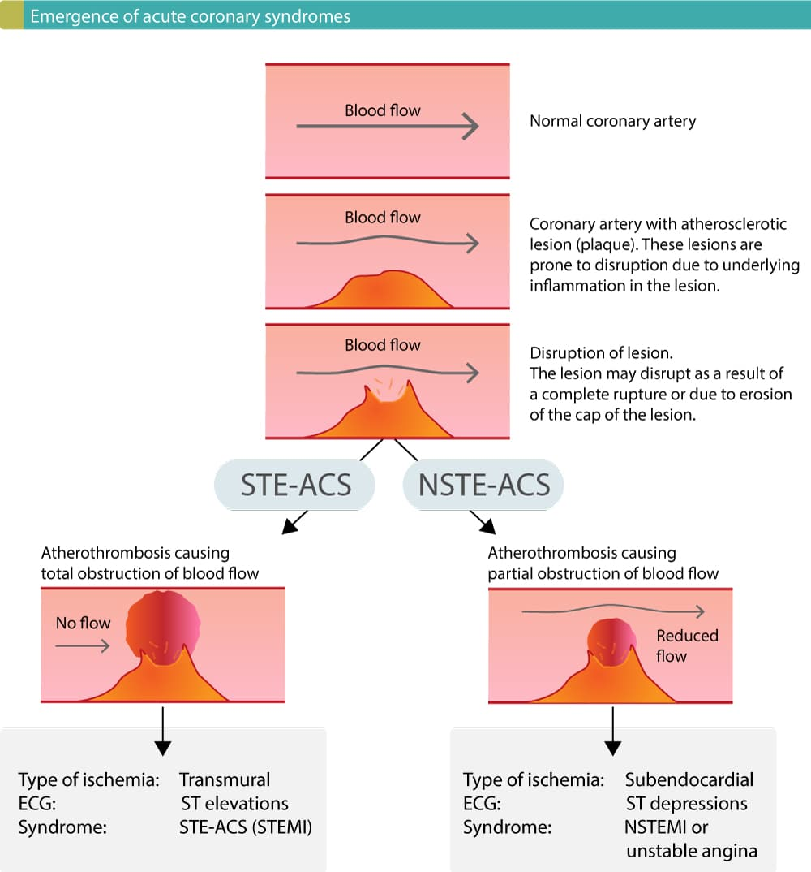

Slide 212
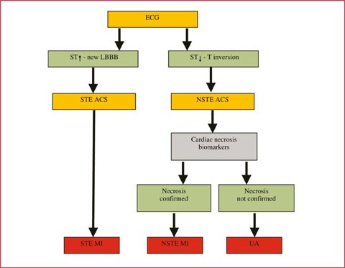

Slide 213
Investigations: Electrocardiography
Confirmatory diagnosis
But difficult to interpret if there is bundle branch block or previous MI.
Repeated ECGs are important: initial ECG may be
normal or non-diagnostic in one-third of cases
ECG changes are best seen in the leads that ‘face’ the ischaemic or infarcted area
ST-segment deviation
ST-segment elevation
T wave inversion - change in ventricular repolarisation
persists after the ST segment has returned to normal.
reliable for the approximate age of the infarct to be
deduced.

Slide 214
Investigations: Electrocardiography
a Normal ECG complex. B Acute ST elevation (‘the current of injury’). C Progressive loss of the R wave, developing Q wave, resolution of the
ST elevation and terminal T wave inversion. d Deep Q wave and T- wave
inversion. E Old or established infarct pattern

Slide 215
Investigations: Electrocardiography
Non-ST segment elevation ACS
Partial occlusion of a major vessel or complete occlusion of a minor vessel,
unstable angina or partial thickness (subendocardial) MI.
ST-segment depression and T-wave changes.
Presence of infarction: loss of R waves in the absence of Q waves

Slide 216
CARDIAC MARKER

Slide 217
Investigations: Plasma Cardiac Markers
Creatine kinase (CK) and troponin T (TnT) are the first to
rise, followed by aspartate aminotransferase (AST) and then lactate
(hydroxybutyrate) dehydrogenase (LDH)

Slide 218
Differentials for ST-Segment
Elevation Myocardial Infarction
Comorbid ischemia | ST elevation but no ischemia | Chest pain but no ischemia
Aortic dissection | Early repolarization | Aortic dissection
Systemic arterial embolism | Left ventricular hypertrophy | Myopericarditis
Hypertensive crisis | Left bundle branch block | Pleuritis
Aortic stenosis | Hyperkalemia | Pulmonary embolism
Cocaine use | Brugada syndrome | Costochondritis
Arteritis |  | Gastrointestinal disorders

Slide 219
Investigations: Plasma Cardiac Markers
Unstable Angina: no detectable rise in cardiac markers or enzymes
Myocardial Infarction: creatine kinase (CK), a more sensitive and cardiospecific isoform of this enzyme (CK-MB), and the cardiospecific proteins, troponins T and I
Also present in skeletal muscle but not CK-MB
intramuscular injection,
vigorous physical exercise
particularly in older people,
a fall

